Slide 1
Paul Duthie, 11th March 2022

Slide 2
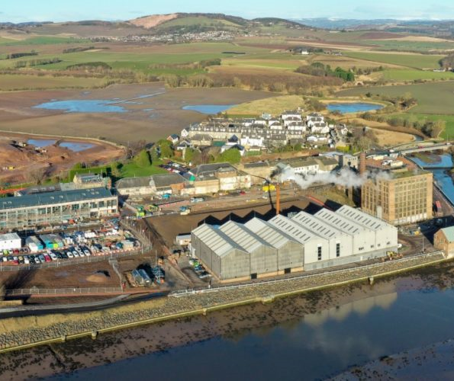
Clean Growth Ambition
“To help Tay Cities Region partners capture and develop a regional vision, proposition and route map to help deliver “Clean Growth” jobs and investment”
Eden Campus

Slide 3
Position Within Tay Cities
Regional Economic Strategy Action Plan
Cross-Partner Working Group
- Reports to Innovative & International Board
- Supported by Community of Practice

Slide 4
Clean Growth Vision
“Tay Cities Region will be an inclusive, vibrant and net-zero carbon economy by 2045. On our journey the region will become the location of choice for companies to test, demonstrate and roll out innovations in clean growth that will combat climate change and generate economic prosperity. We will align our passion, skills, innovation assets and places behind this overarching goal.”

Slide 5
Clean Growth Proposition
Key Innovation Markets:
Energy Management
Sustainable Mobility
Green Agri-tech
Circular Economy
Real-world test bed
Attract New Talent
Embrace New Concepts

Slide 6
Clean Growth Projects

Slide 7
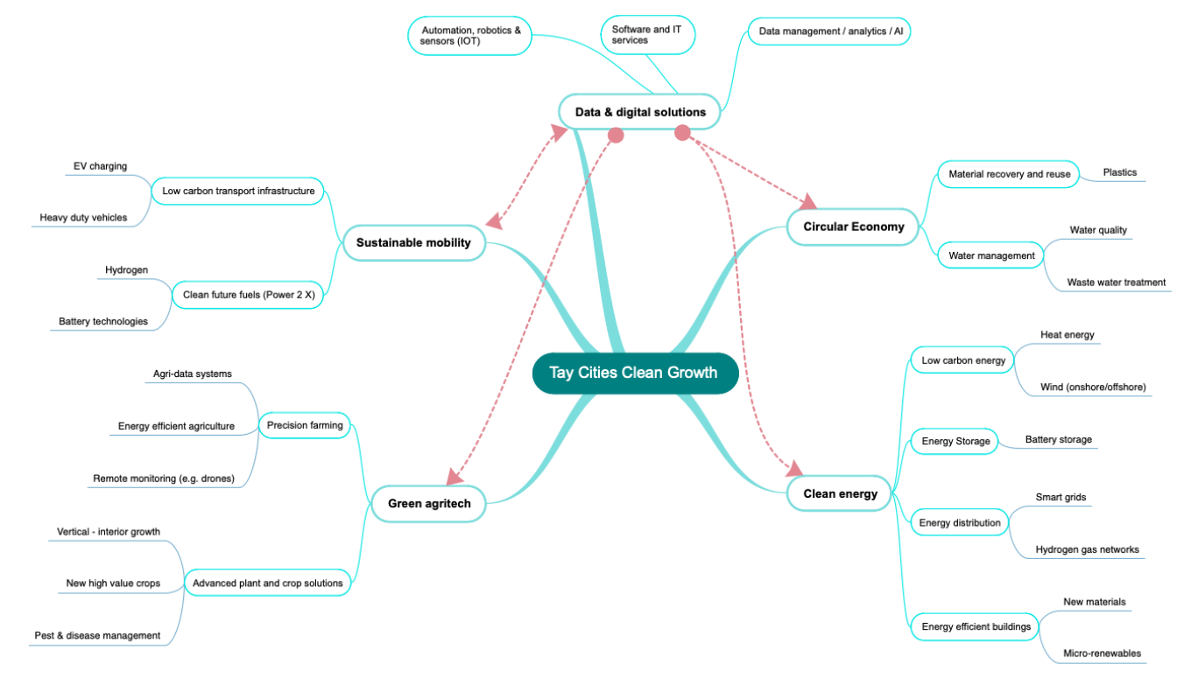
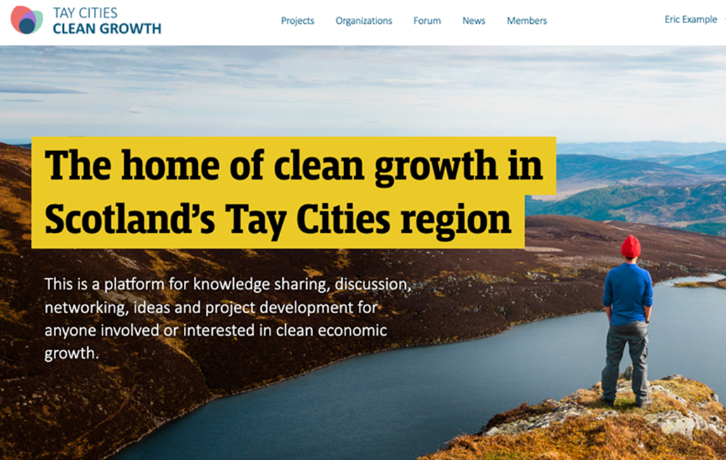
Mapping & Website Outputs
Mapping
Projects, Ecosystem, Tech
Competitive Advantages
Website
Knowledge Sharing
Drive Project Synergies
Promotion Material
Clean Growth Proposition
Narrative to Promote Region

Slide 8
Sector Categorisation

Slide 9
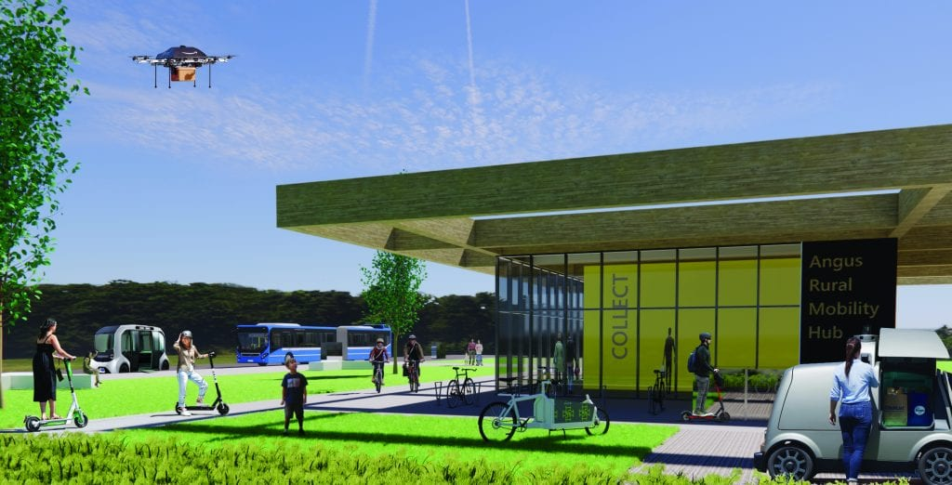
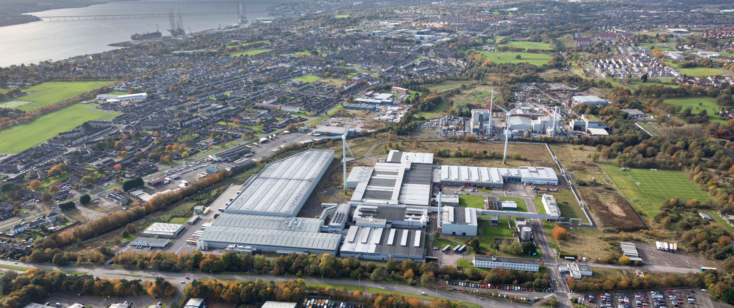
Example: Sustainable Mobility Synergies
HGV Battery & Hydrogen Technologies > Concept to Reality
Perth Innovation Highway
Photo: www.perthwest.com
Angus Rural Mobility Hub
Photo: https://www.investinangus.com/tay-cities-deal/the-angus-fund/low-carbon/angus-rural-mobility-hub/
University of St Andrews - Eden Campus
Photo: https://edencampus.st-andrews.ac.uk/
Michelin Scotland Innovation Parc

Slide 10
Example: Sustainable Mobility Synergies
Research & Incubation
Eden Campus
Training & Testing
Manufacturing & Scale-up
Strategic Infrastructure & Real-world Test Beds
Michelin Scotland Innovation Parc
Eden Campus
Michelin Scotland Innovation Parc
Regional Position =
Investment & Jobs:
Development & Testing,
Manufacturing & Servicing
Michelin Scotland Innovation Parc
Perth Innovation Highway
Angus Rural Mobility Hub

Slide 11
Clean Growth Website

Slide 12
Website Development

Slide 13
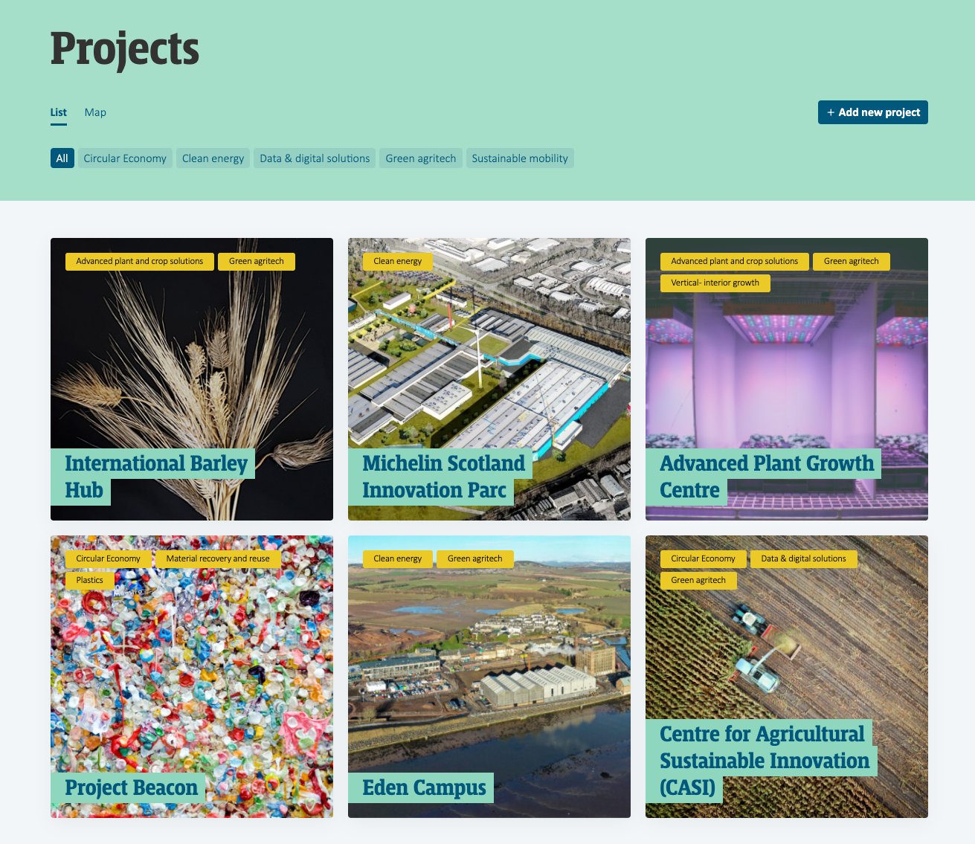
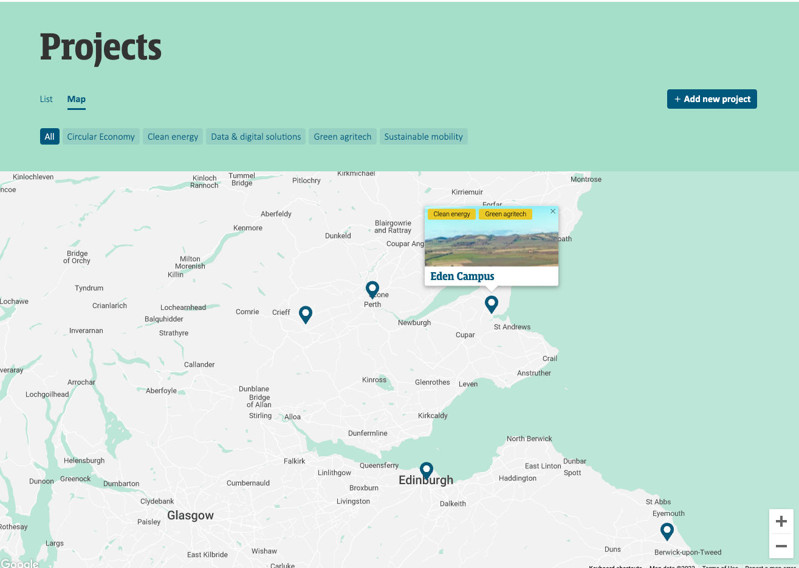
Projects Database & Showcase

Slide 14
Next Steps
Complete Action Plan
Website Launch
Return to Joint Committee - Summer 2022

Slide 15
@taycities www.taycities.co.uk paul.duthie@scotent.co.uk

