Slide 1
Tay Cities Region Deal
Annual Performance Report

Slide 2
Annual Performance Report
The Annual Performance Report is an annual commitment for the Deal to provide an update on the Deal for period Q2 to Q2
It sets out what the Partnership has achieved
The Report was submitted to both Governments in December 2021 and informed the Annual Conversation, which was held on 10th February 2022
Both Governments complimented the Partnership on their Annual Performance Report
The PMO received very few comments on the draft Annual Performance Report from the Partnership & Governments
Main changes to the document have been related to formatting and minor corrections, but the content has remained the same

Slide 3
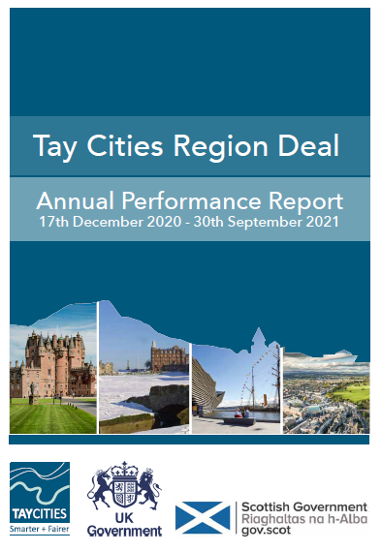
Next Steps
Approval is sought by the Joint Committee to approve the Annual Performance Report for publication
It will be uploaded to the Tay Cities website and PR opportunities in discussion with the PR & Comms Group. This will utilise some of the press for the 1 Year Anniversary in December 2021
The Annual Performance Report is a public document and will be updated annually (start of Q3 to end of Q2)

Slide 4
@taycities www.taycities.co.uk lauren.hollas@taycities.co.uk

