Slide 1
Joint Committee PMO Update 11th March 2022

Slide 2
Business Cases with Joint Committee Approval
Project Reference and Name | FBC approved by Govts | FBC and OBC Approval by Joint Committee
TCD014 Eden Campus | 03/09/2020 | 21/08/2020
TCD021 Regional Culture and Tourism Investment Programme | 08/04/2020 | 19/06/2020
TCD021 (a) Hospitalfield | Not required | 17/07/2020
TCD016 Growing the Tay Cities Biomedical Cluster | 20/11/2020 | 19/02/2021
TDC012 Angus Fund | 24/09/2020 | 19/02/2021
TCD002 Dundee Airport Investment (Revenue) | 12/11/2020 | 19/02/2021
TCD010 Advanced Plant Growth Centre | 10/03/2021 | 19/03/2021
TCD011 International Barley Hub | 10/03/2021 | 19/03/2021
TCD017 Perth Cultural Transformation (City Hall) | 17/02/2021 | 19/03/2021
TCD021 (b) Discovery Point | Not required | 23/04/2021
TCD013 cyberQuarter | 24/05/2021 | 18/06/2021
TCD005 & TCD006 Rural Angus and Rural Perth and Kinross Highspeed Broadband | 13/05/2021 | 18/06/2021
TCD007 5G Digital Testbeds | 21/12/2021 | 17/09/2021
TCD029 Stretch Dome Simulator | 26/08/2021 | 10/12/2021

Slide 3
Deal Programme Timetable
Activity | Jan 2022 | Feb 2022 | Mar 2022 Joint Committee | Apr 2022 | May 2022 | Jun 2022 Joint Committee
2021/22 Grant Offer Letter V2 - The Stretch Dome Simulator Project secured JC approval in December 2021 so a revision of the GoL is required to reflect this. |  | 21/22 Grant Offer Letter V2
Annual Conversation - meeting with the Accountable Body to formally review progress in reviewing the Deal. |  | Annual Conversation 10th February
Benefits Realisation Plan - completion and submission of the Partnerships Benefits Realisation Plan. The BRP is being presented to JC on 11th March 2022. |  |  | Submit to Governments 31st March
Annual Report - presented to Joint Committee for approval on 11th March 2022. To be published by end of March. |  |  | Annual Report to Joint Committee 11th March
2022/23 Ask & Grant Offer Letter - Partnerships ‘ask’ for accelerated funding from Scottish Government and letter setting out the Scottish Governments Offer to the Partnership for 22/23. |  |  | 2022/23 Ask for Acceleration to Scottish Govt | 22/23 Grant Offer Letter
Annual review of the Implementation Plan - commitment to review and submit to the Governments. Will be informed by Benefits Realisation work. |  |  |  |  |  | Submit to Governments 30th June
Project Owner Events - events to update Project/ Programme Owners on key messages and activities | UK Green Book Training |  | Project Owner Event 1st March |  | Project Owner Event
Scottish PMO Networking Group - chaired and secretariat provided by Tay Cities | Network Meeting 26th Jan |  | Network Meeting 16th March |  | Network Meeting 11th May

Slide 4
Year 2 Programmes/Projects Business Case Timetable
Key : OBC – Outline Business Case
FBC – Full Business Case
BJC – Business Justification Case
MG- Consideration by Management Group
JC – Decision by Joint Committee
Estimated volume expected at each meeting
Key : OBC – Outline Business Case
FBC – Full Business Case
BJC – Business Justification Case
MG- Consideration by Management Group
JC – Decision by Joint Committee
Project/Programme | Jan 2022 | Feb 2022 | Mar 2022 Joint Committee | Apr 2022 | May 2022 | Jun 2022 Joint Committee | Jul 2022 | Aug 2022 | Sep 2022 Joint Committee
Year 2 (21/22) profiled Projects/Programmes
TCD007 5G Digital Testbeds | BJC to MG |  | BJC to JC
TCD008 Low Carbon Transport and Active Travel Hubs (Programme OBC & Phase 1 Project FBC) | Programme OBC to MG (inc. phase 1 FBC) |  |  |  |  | Programme OBC to MG (inc. phase 1 FBC)
TCD025 Tay Cities Engineering Partnership |  | FBC to MG | FBC to JC
TCD024 Tay Cities Skills and Employability Development Programme |  | Programme OBC to MG (incl. Project Manager BJC) | Programme OBC to JC (incl. Project Manager BJC)
TCD024 Tay Cities Skills and Employability Development Programme - Digital Skills Project |  |  |  |  | BJC to MG | BJC to JC
TCD024 Tay Cities Skills and Employability Development Programme - Life Sciences Project |  |  |  |  | BJC to MG | BJC to JC
TCD024 Tay Cities Skills and Employability Development Programme - SMEs Project |  |  |  |  | OBC to MG |  |  | FBC to MG | FBC to JC
TCD024 Tay Cities Skills and Employability Development Programme - Hospitality Project |  |  |  |  |  |  |  | OBC to MG
2021/22 YEAR END

Slide 5
Year 3 Programmes/Projects Business Case Timetable
Estimated volume expected at each meeting
Key : OBC – Outline Business Case
FBC – Full Business Case
BJC – Business Justification Case
MG- Consideration by Management Group
JC – Decision by Joint Committee
Project/Programme | Apr 2022 | May 2022 | Jun 2022 Joint Committee | Jul 2022 | Aug 2022 | Sep 2022 Joint Committee | Oct 2022 | Nov 2022 | Dec 2022 Joint Committee
TCD024 Tay Cities Skills and Employability Development Programme - Digital Skills Revenue |  | BJC to MG | BJC to JC
TCD024 Tay Cities Skills and Employability Development Programme - Life Sciences |  | BJC to MG | BJC to JC
TCD024 Tay Cities Skills and Employability Development Programme - SMEs |  | OBC to MG |  |  | FBC to MG | FBC to JC
TCD024 Tay Cities Skills and Employability Development Programme - Hospitality |  |  |  |  | OBC to MG
TCD012 Angus Fund - Centre for Agricultural Sustainable Innovation (CASI) |  |  | OBC to MG TBC
TCD012 Angus Fund - Mercury Drone Port |  |  | BJC to MG TBC |  |  | BJC to JC TBC
TCD023 Aviation Academy for Scotland |  |  | TBC by Project Owner
TCD020 Perth Innovation Highway Capital |  |  | TBC by Project Owner
TCD021 Regional Culture and Tourism Investment Programme REFRESH |  |  |  |  |  |  |  |  | OBC to MG

Slide 6
Annual Conversation
Headlines:
The Partnerships first Annual Conversation was held on the 10th February 2022
The Partnership were commended on their first year of delivery
The Scottish Government highlighted the importance of the Skills Programme having a realistic and deliverable profile going forward
Both Governments expressed a desire to come for several days for an in person programme of meetings/visits covering the region later in the year
Final Annual Performance Report is due to be published at the end of March 2022

Slide 7
Headlines for Year 2 Capital Profile
Headlines:
Total Capital Deal Profile Funding in Grant Offer Letter - £40.832m (Deal signing profile £31.336m plus £9m accelerated funding)
Forecast Drawdown at 31st January 2022 - £34.071m
Current forecast underspend at year end (from January monthly forecast) - £6.461m (15% of awarded funding)
Programme Management accelerated funding is £1.236m
Current forecast underspend is therefore £5.225m

Slide 8
Year 2 2021/22 Capital Drawdown Page 1 of 5
CAPITAL Drawdown Monitoring 2021/22 (Year 2) January Monthly Forecast 31/01/2022 *Note: profile amend refers to any approved permanent changes to the profile e.g. accelerated funding, transfer of funds from revenue to capital
Project Name | Deal Profile (£000) | Profile Amend (£000) | Updated Profile (£000) | Forecast Drawdown (£000) | Current Year Variance Minimum (£000) | Comments
TCD025 Tay Cities Engineering Partnership | 0 | 496 | 496 | 289 | (207) | Underspend of £207k. Project previously indicated full drawdown. Project Owner is now forecasting an underspend of £207k. They have indicated that they are currently spending at risk but are unable to purchase and receive equipment before the end of the financial year in order to claim their full allocation.
TCD021 Growing the Tay Cities Biomedical Cluster | 3,199 | 0 | 3,199 | 1,342 | (1,857) | Increased underspend of £1.009m. Project previously indicated an underspend of £848k. Project Owner has now indicated an underspend of £1.857m, which is an increased underspend of £1.009m. Project Owner has also indicated programme delays with the construction start date moved from 2021/22 to 2022/23 due to land transfer issues.
TCD011 JHI International Barley Hub | 6,250 | 507 | 6,757 | 6,757 | 0 | No Change. At a project meeting with Governments on 11/01/22, the project indicated potential additional spend of £3m over their allocated funding in this financial year across both of the JHI projects. The Partnership is in regular communication with the Project Owner to secure this acceleration if possible.
TCD010 JHI Advanced Plant Growth Centre | 0 | 4,493 | 4,493 | 4,493 | 0 | No Change. At a project meeting with Governments on 11/01/22, the project indicated potential additional spend of £3m over their allocated funding in this financial year across both of the JHI projects. The Partnership is in regular communication with the Project Owner to secure this acceleration if possible.

Slide 9
Year 2 2021/22 Capital Drawdown Page 2 of 5
CAPITAL Drawdown Monitoring 2021/22 (Year 2) January Monthly Forecast 31/01/2022 *Note: profile amend refers to any approved permanent changes to the profile e.g. accelerated funding, transfer of funds from revenue to capital
Project Name | Deal Profile (£000) | Profile Amend (£000) | Updated Profile (£000) | Forecast Drawdown (£000) | Current Year Variance Minimum (£000) | Comments
TCD013 cyberQuarter | 4,100 | 0 | 4,100 | 4,100 | 0 | No Change. Project Owner are forecasting full drawdown by the end of Q4. The Project are no longer indicating the additional spend over allocated drawdown of £437k.
TCD014 Eden Campus | 6,924 | 2,000 | 8,924 | 7,341 | (1,583) | The project are forecasting an additional £739k underspend. The figures shown include the accelerated award of £2m by the Scottish Government and the Partnership to the Project, received in April 2021.
TCD029 Stretch Dome Simulator | 0 | 0 | 0 | 300 | 300 | Acceleration of funding. The project has spent at risk in 2021 and the Partnership has offered accelerated funding of £300k this financial year as part of its Deal Programme management. The Project was originally due to drawdown in year 10. The Joint Committee approved the BJC in December 2021. The 21/22 Grant Offer letter is being revised to show this project.

Slide 10
Year 2 2021/22 Capital Drawdown Page 3 of 5
CAPITAL Drawdown Monitoring 2021/22 (Year 2) January Monthly Forecast 31/01/2022 *Note: profile amend refers to any approved permanent changes to the profile e.g. accelerated funding, transfer of funds from revenue to capital
Project Name | Deal Profile (£000) | Profile Amend (£000) | Updated Profile (£000) | Forecast Drawdown (£000) | Current Year Variance Minimum (£000) | Comments
TCD021 Regional Cultural and Tourism Investment Programme - unallocated | 1,143 | 0 | 1.143 | 0 | (1,143) | No change. The Programme was awarded £3.651m in year 2. £1.143m has been unallocated and therefore has not been able to be drawn down.
TCD021 Regional Cultural and Tourism Programme - Hospitalfield | 1,608 | 0 | 1,608 | 911 | (697) | Increased underspend of £676k from £21k. There has been slippage in claims due to delays with on site works.
TCD021 Regional Cultural and Tourism Programme – Discovery Point Transformed | 900 | 0 | 900 | 900 | 0 | Total awarded funding for year 2 now drawn down.

Slide 11
Year 2 2021/22 Capital Drawdown Page 4 of 5
CAPITAL Drawdown Monitoring 2021/22 (Year 2) January Monthly Forecast 31/01/2022 *Note: profile amend refers to any approved permanent changes to the profile e.g. accelerated funding, transfer of funds from revenue to capital
Project Name | Deal Profile (£000) | Profile Amend (£000) | Updated Profile (£000) | Forecast Drawdown (£000) | Current Year Variance Minimum (£000) | Comments
TCD017 Perth Cultural Transformation (City Hall) | 4,327 | 2,000 | 6,327 | 7,263 | 936 | Acceleration of Funding. Acceleration of £2m was awarded to this Project in April 2021 by the Scottish Government and Partnership. The project has also been awarded acceleration of £936k in this financial year (from year 3). The Project has achieved £2.936m acceleration in 21/22. This completes the Project’s full allocation.
TCD005/06 Rural Angus and Rural Perth & Kinross High Speed Broadband | 1,800 | 0 | 1,800 | 1,800 | 0 | No change. Project is indicating drawdown of full allocation this financial year.
TCD007 5G Digital Testbeds | 450 | 0 | 450 | 91 | (359) | Underspend has increased by £259k. Project have identified £359k underspend as a result of being unable to source equipment.
TCD008 Low Carbon Transport and Active Travel Hub | 635 | 0 | 635 | 20 | (615) | Underspend of £615 identified. The Project was previously indicating a possible delay in drawdown due to procurement. The Project has now indicated a £615k underspend this financial year.

Slide 12
Year 2 2021/22 Capital Drawdown Page 5 of 5
CAPITAL Drawdown Monitoring 2021/22 (Year 2) January Monthly Forecast 31/01/2022 *Note: profile amend refers to any approved permanent changes to the profile e.g. accelerated funding, transfer of funds from revenue to capital
Project Name | Deal Profile (£000) | Profile Amend* (£000) | Updated Profile (£000) | Forecast Drawdown (£000) | Current Year Variance Minimum (£000) | Comments
Project Capital Drawdown | 31,336 | 9,496 | 40,832 | 34,371 | (6,461) | The capital Programme is indicating a forecast of £6.761m underspend against allocated drawdown.
Accelerated Capital Drawdown | - | 1,236 | - | 1,236 | 1,236 | The acceleration of funding offered to Perth Cultural Transformation (£936k) and Stretch Dome Simulator (£300k) will result in an overall decrease in underspend for the Programme.
Total Capital Drawdown | 31,336 | 10,732 | 40,832 | 35,307 | (5,225) | Taking account of accelerated funding, the capital Programme is indicating a forecast of £5.525m underspend again allocated drawdown.

Slide 13
Year 3 - Programme Management
Headlines:
A total of £4.586m has been identified as confirmed/potential underspend in year 3
£2.273m is confirmed underspend against awarded profile to reflect the acceleration to the City Hall Project and confirmation from the Innovation Highway Project that they will now not start to drawdown until year 5.
£285k is currently unallocated to any project in the Regional Culture and Tourism Programme. Hospitalfield have made an ask for their Phase 1 funding underspend £697k in year 2 to be allocated to them in year 3.

Slide 14
Projects indicating an ‘Ask’ in Year 3 (with Joint Committee Business Case Approval)
Project | Value of ‘Ask’ £000 | Comment
International Barley Hub | 6,112 | Funding gap has been identified by the project. Project are currently forecasting spend of £9.723m in Y3. This is £6.112m more than profiled at Deal signing. If awarded acceleration would be taken from the end of the Projects profile (year 7)
Advanced Plant Growth Centre | 5,838 | Funding gap has been identified by the project. Project are currently forecasting spend of £8.136m in Y3. This is £5.838m more than profiled at Deal signing. If awarded acceleration would be taken from the end of the Projects profile (year 9 and year 10)
Eden Campus | 1,583 | Request to accelerate from forecast year 10 underspend placement. The project have indicated that this wish to request their forecast underspend of £1,583 from year 2 in year 3 in addition to their year 3 awarded profile
Hospitalfield | 697 | Hospitalfield have indicated an ask of £697k for Phase 1 (which has JC approval) and a further £1.103m for Phase 2 (which is subject to JC conditions being met). This exceeds the potential £285k available from the Culture & Tourism Programme.
Total | £14,230 | It should be noted that TCEP have an underspend of £207k which they are requesting as an ask in year 3. Their Business Case is subject to Joint Committee approval. This also does not include the ask from Hospitalfield for Phase 2 which does not have Business Case approval to drawdown.

Slide 15
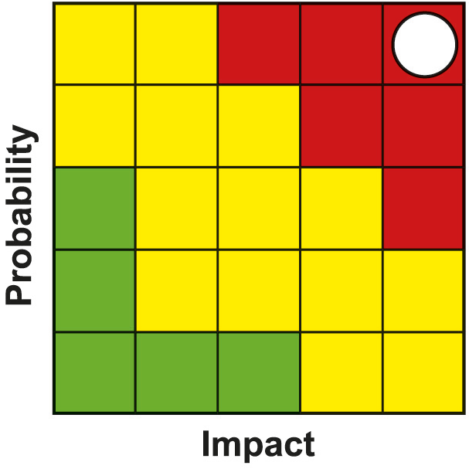
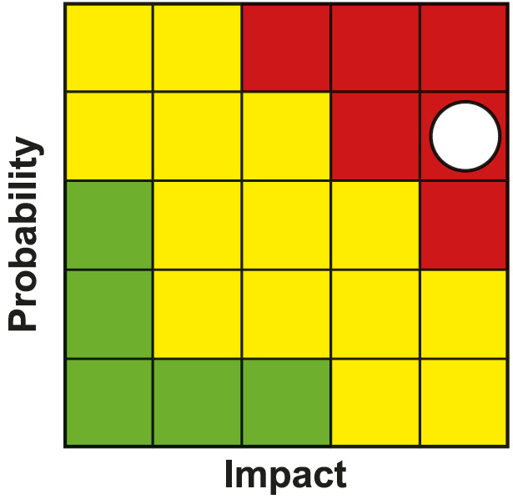
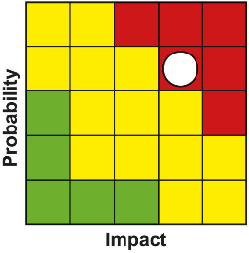
Programme Risk Register
PMO lead Clare Slater, Project Manager
Risk | Impact | Likelihood | Severity | Resolution Plan or Mitigating Action
Covid-19 impacting on the TCD projects resulting in potential delays and cost increases | 5 | 5 | 25 | Regular updating of progress report and monthly financial forecasts, so that project leads can inform PMO of any issue well in advance, and PMO can raise with Government, Thematic Boards, Management Group, Finance Directors Group and Joint Committee as appropriate. Thematic Boards will be engaged with to work with Projects to understand supply chain exposures and contingency plans. Project have been mandated to include Covid-19 Assessments within all Business Cases. Regular review of outputs and timelines for delivery of benefits in light of Covid-19 is being developed. As part of the work to develop the benefits realisation plan this will include a Monitoring and Evaluation Framework and a change management process. PMO engaging with Local PMO network to share intelligence with Projects and Governments.
Impacts of Brexit | 4 | 5 | 20 | Regular engagement with project leads to highlight any risks well in advance, so that PMO can raise with Government, Thematic Boards, Management Group, Finance Directors Group and Joint Committee as appropriate. Scottish Enterprise (SE) leading on behalf of the Partnership work to understand supply chain exposures and contingency plans. S.E. have shared a Brexit Exposure tool. A workshop is proposed in February.
Delays in development and approval of business cases | 4 | 4 | 16 | PMO working closely with project leads and policy leads within UKG and SG to support business case development and approval to an agreed timeline. Issues e.g. project capacity & Covid-19 to be raised through governance. Regular programme monitoring and reporting. Continue to spend according to agreed profile. Programme of Outreach and Virtual events outlining governance timescales to mitigate delays in development with projects; Regular meetings with years 1, 2 and 3 projects have been set up to keep regular contact with projects.

Slide 16
Programme Risk Register
PMO lead Clare Slater, Project Manager
Risk | Impact | Likelihood | Severity | Resolution Plan or Mitigating Action
PMO Resource and capacity issues | 4 | 4 | 16 | Taking staff time to be trained will put PMO capacity under pressure at year end and for at least 6 months after recruitment. New Project Manager in Team, however it resulted in loss of Project Officer. Loss of PMO administrator/coordinator through retirement. More permanent contracts being considered in line with other Deal PMO’s and partners.
Failure to deliver individual projects within the TCD programme | 4 | 4 | 16 | Regular dialogue/reporting around progress takes place between PMO and Project Leads where issues are raised in advance and, if appropriate, escalated to Government, Thematic Boards, Management Group, Finance Directors Group and Joint Committee. Programme Management reporting in place. Regular meetings with years 2,3 and 4 projects have been set up to keep regular contact with projects. Management Group and other governance arrangements in place to monitor project development. PMO will escalate any issues relating to individual projects through existing governance arrangements
Programme Management | 4 | 4 | 16 | A number of projects are forecasting an underspend. The underspend will be placed in year 10 at the Project Owners risk. Due to inflationary pressures, there is a risk that awards to projects later in the Deal may represent less value for money and has the potential to impact on the deliverables for each project. A number of projects are indicating increased construction costs. Many have indicated to address this through Value Engineering which has highlighted potential risks to outputs and benefits. The PMO will monitor this through the Project Owner meetings.

Slide 17
@taycities www.taycities.co.uk morag.saunders@taycities.co.uk

