Slide 1
Tay Cities Engineering Partnership
Jim Brown
Strategic Projects Director
Dundee and Angus College

Slide 2
Tay Cities Engineering Partnership
Partners
D&A College
Fife College
Perth College UHI
Angus Training Group
Angus Council
Perth and Kinross Council

Slide 3
TCEP Partnerships / Engagement
Seagreen Offshore Windfarm – Funding Secured
Crown Estates Scotland ZeroFour Hub – MoU
Scottish Manufacturing Advisory Service (SMAS)
Tayside Engineering Network
Offshore Wind Partners Group
Forth and Tay Cluster - OSW
National Manufacturing Institute Scotland - Collaboration Agreement
ESP
Advanced Manufacturing Training Network
Wind Training Network
Automotive Training Network
Welding Training Network
MSIP Skills Academy
Dundee Science Centre

Slide 4
Outputs
Engineering and Advanced Manufacturing Centre
Cobot Demonstration Centre
Mobile Technology Unit (in partnership with Dundee Science Centre)
Product Innovation Lab – Aviation Academy (composites)
Product Innovation Lab – Creative Exchange (CAD/CAM)

Slide 5
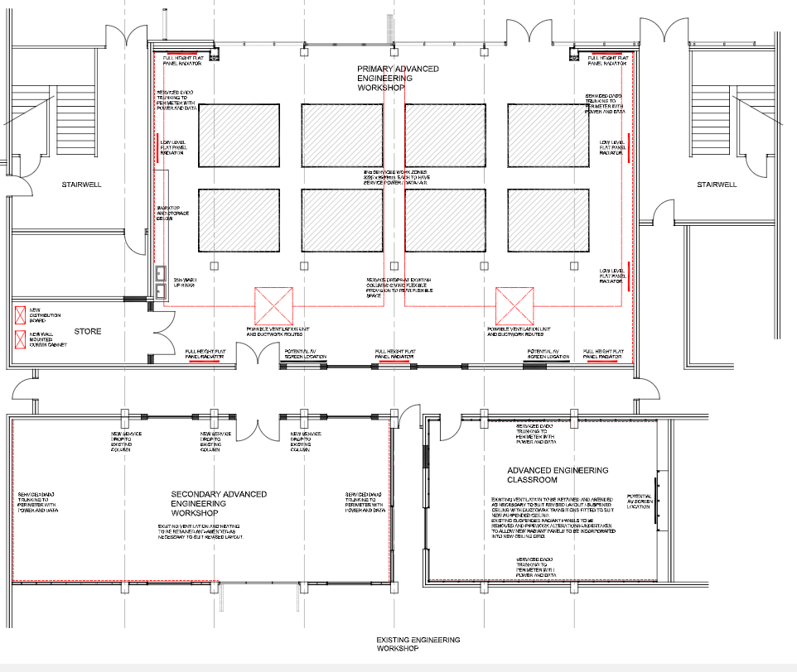
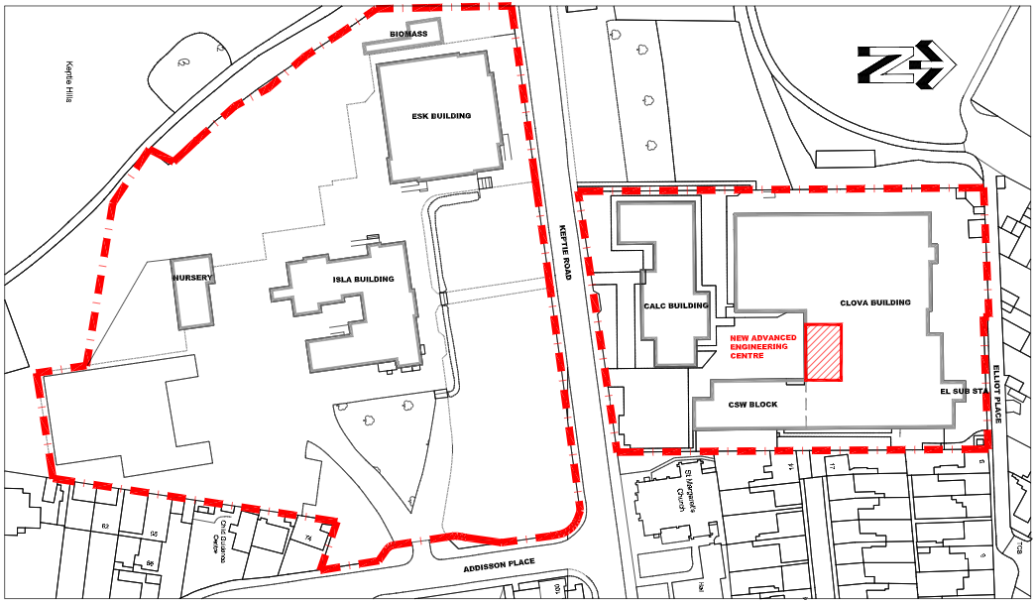
EAM Centre

Slide 6
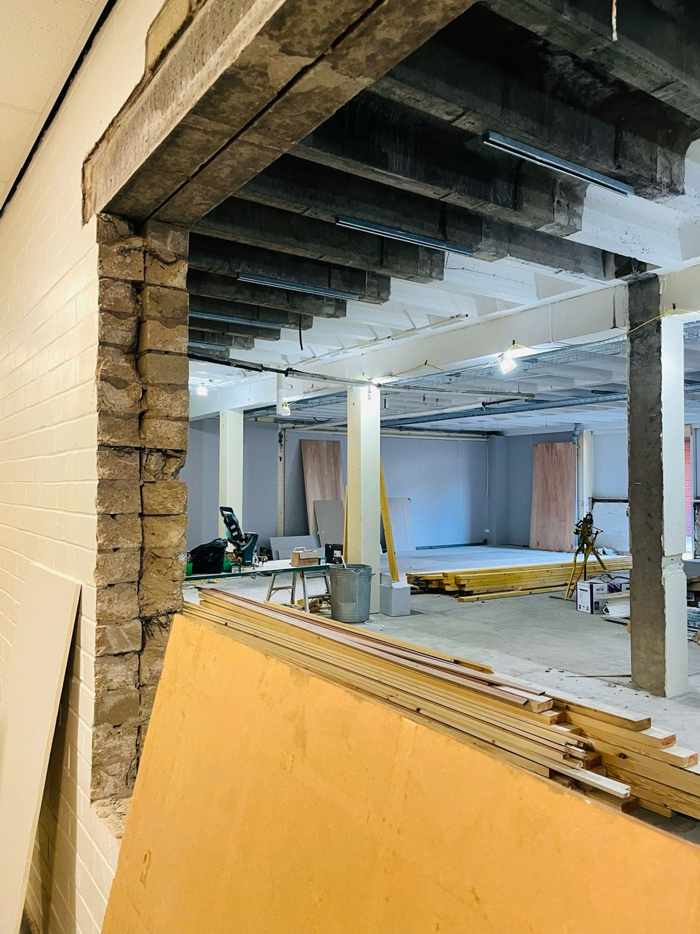
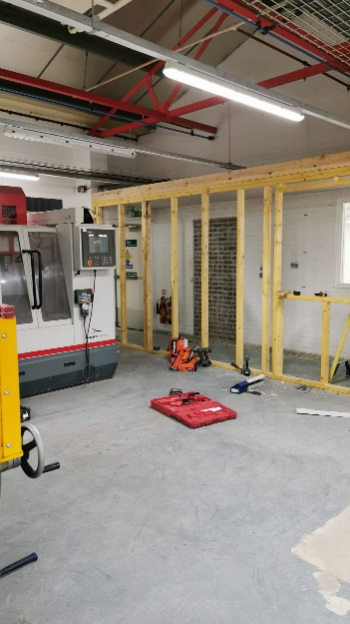
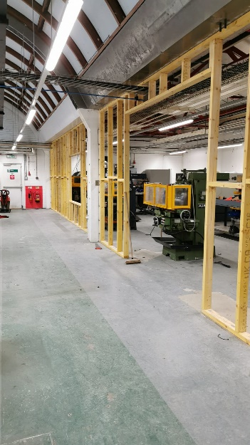
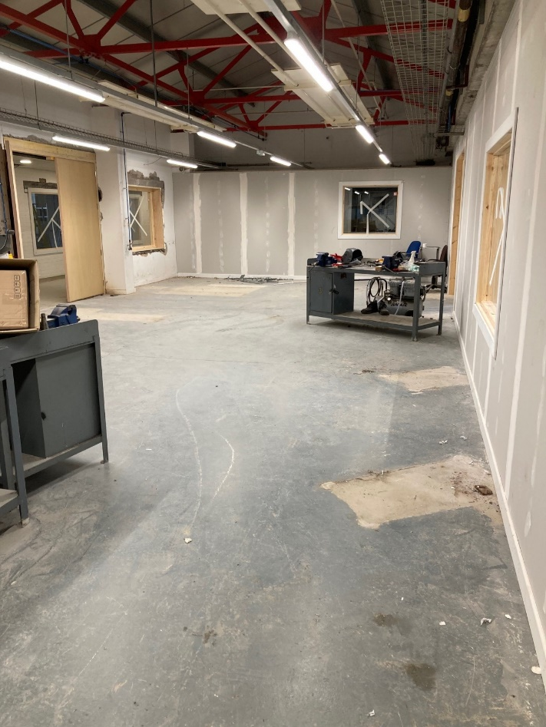
Facilities

Slide 7
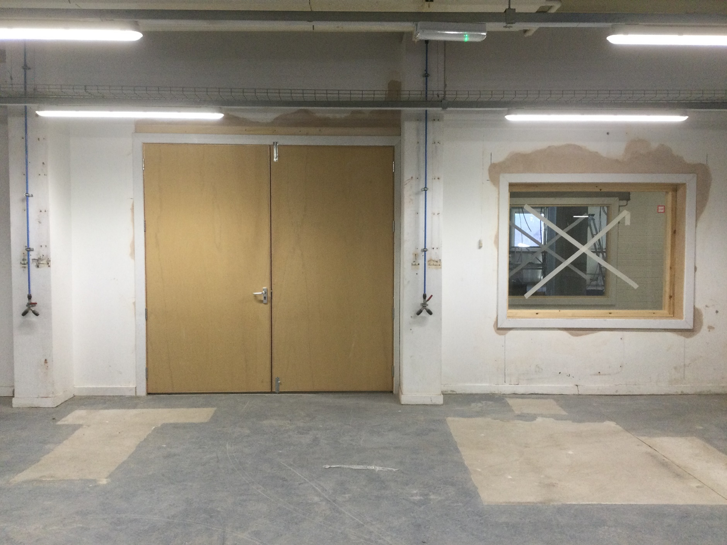
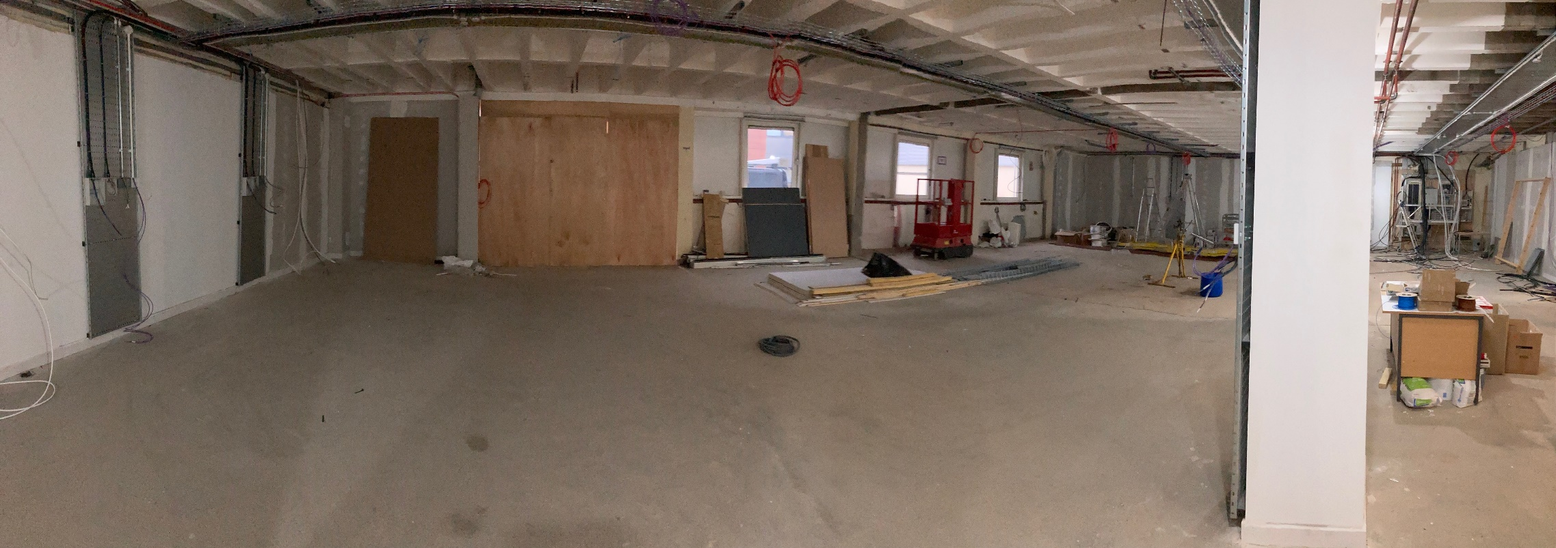
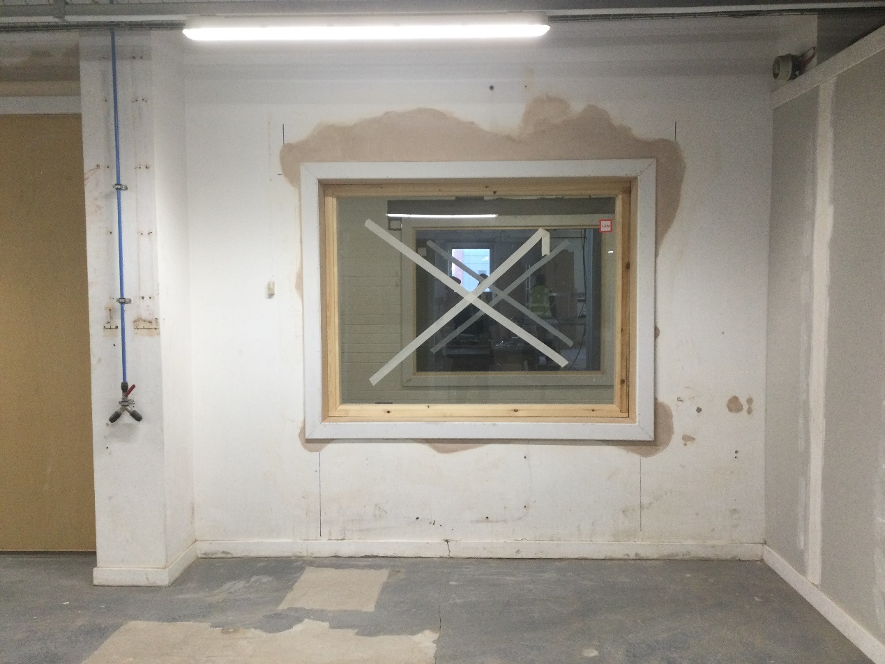
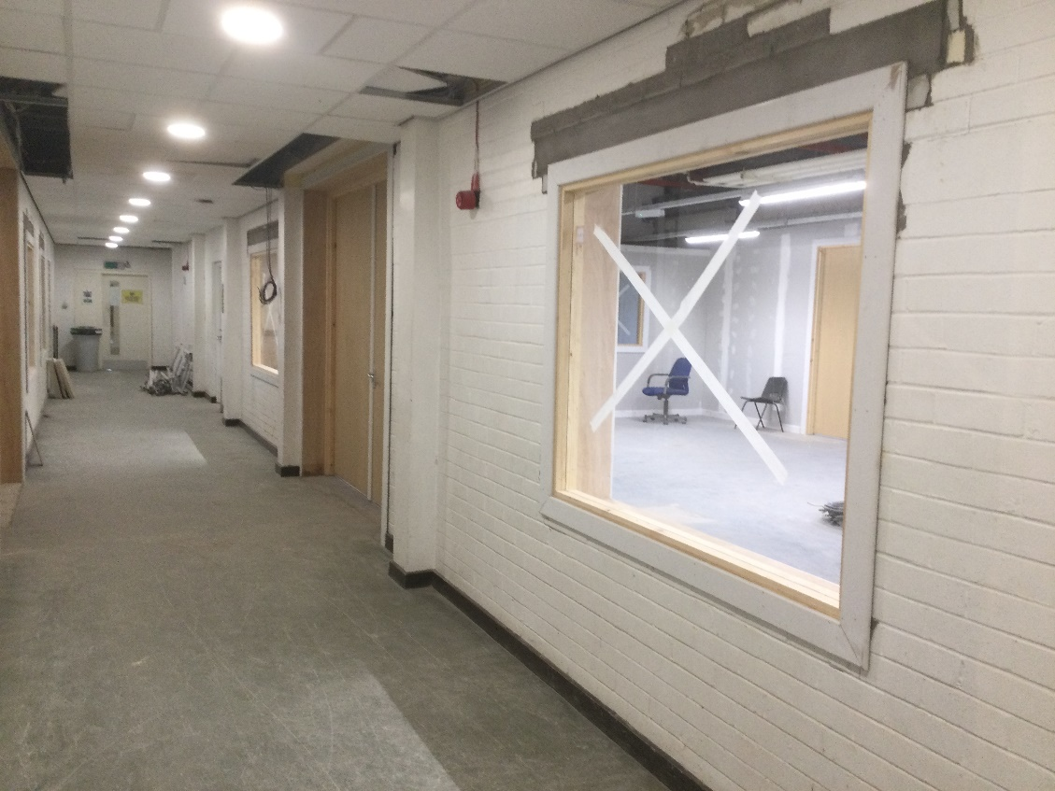

Slide 8
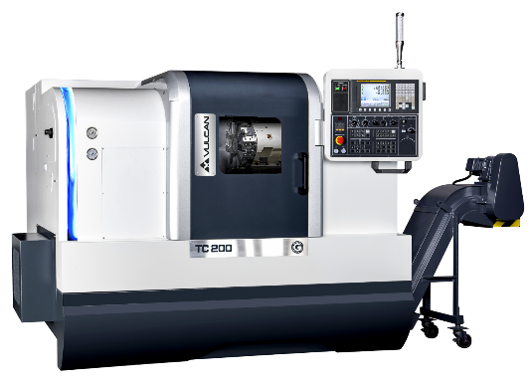
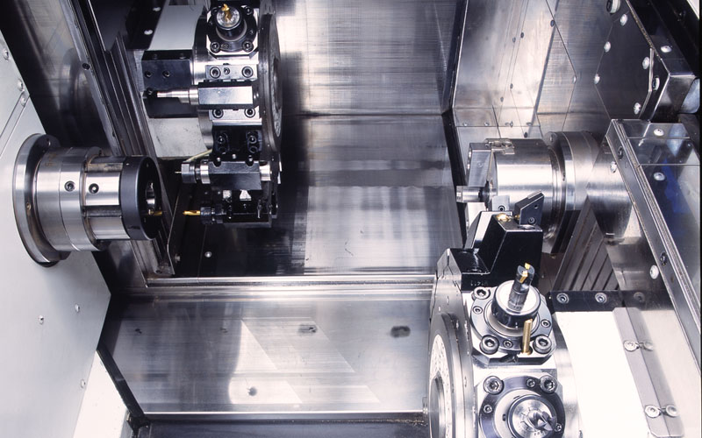
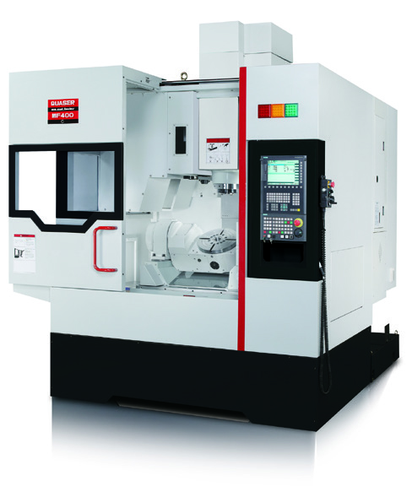
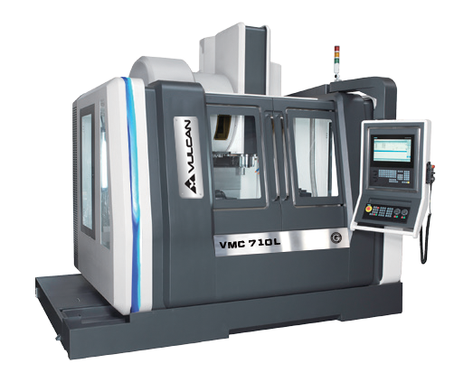
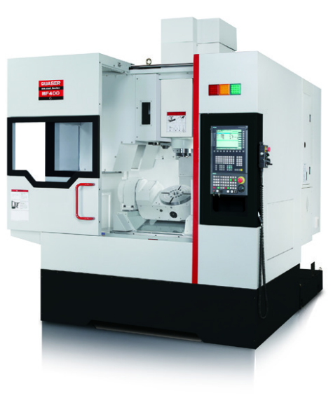
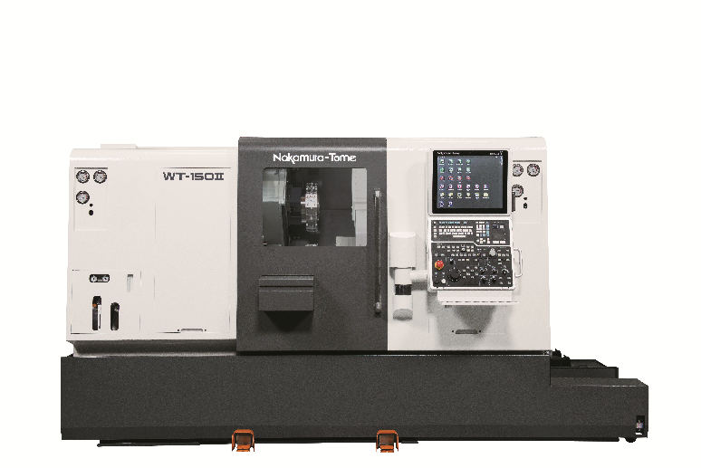
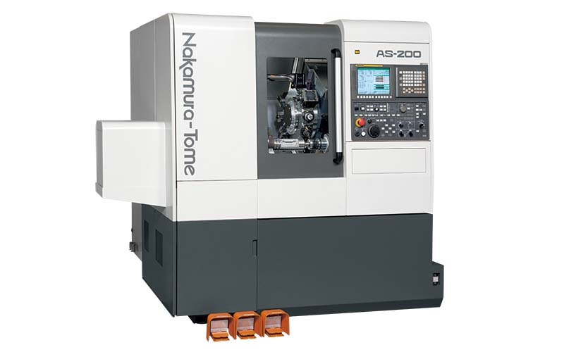
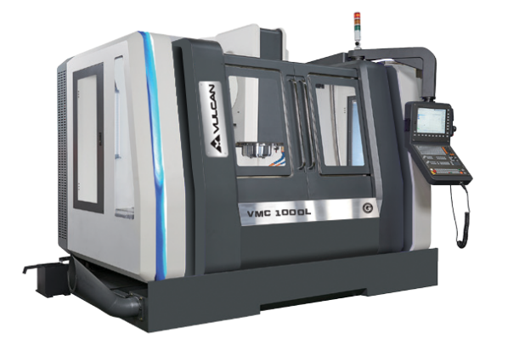
Equipment

Slide 9
Progress to Date
EAM Centre due to complete build March 2022
Skills for the Future Lab Complete (CAD/CAM)
CIC Application Submitted
Capital Equipment procurement specification agreed
Virtual Reality software and hardware commissioned
ZeroFour Crown Estates MoU signed
Seagreen funding secured
Mobile Engagement accelerated in partnership with Dundee Science Centre
Project Manager Recruitment ready to go once approval secured

