Slide 1
Tay Cities Region Deal Joint Committee PMO Update 1st July 2022

Slide 2
Deal Programme Timetable
Activity | June 2022 Joint Committee | July 2022 | August 2022 | September 2022 Joint Committee | October 2022 | November 2022 | December 2022 Joint Committee
2022/23 Grant Offer Letter – Scottish Government have shared a draft. | 24th June 2022
Quarterly Performance Report - financial forecasting and risks | 30th June 2022 | Meeting with Governments |  | 30th September 2022 | Meeting with Governments |  | 31st December 2022
Implementation Plan - Annual Review of Plan due with Governments by 30th June 2022 | 30th June 2022 to Govt subject to MG approval | 28th July 2022 MG approval
Benefits Realisation Plan - continued liaison with all projects to develop Logic Chain Models and Q2/Q4 reporting. |  |  |  | 30th September 2022 reporting
Term Forecast – Q2 and Q4 Grant Offer Letter requirement |  |  | 31st August 2022
Annual Performance Report – draft report to be developed ahead of December submission |  |  |  | 30th September 2022 - drafting |  |  | 15th December 2022 - submission
Governance/Thematic Board review |  | Meetings with TB Chairs |  | September 2022
Project Owner Events - events to update Project/ Programme Owners on key messages and activities | 14th June |  |  | Just Five Minute Networking TBC
Scottish PMO Networking Group - chaired and secretariat provided by Tay Cities |  | Network Meeting 6th July | Network Meeting 31st August |  | Network Meeting 26th October |  | Network Meeting 14th December

Slide 3
Capital Business Cases with Joint Committee Approval
Project Reference and Name | Approved by Govts | Approval by Joint Committee
TCD014 Eden Campus | 03/09/2020 | 21/08/2020
TCD021 Regional Culture and Tourism Investment Programme | 08/04/2020 | 19/06/2020
TCD021 (a) Hospitalfield | Not required | 17/07/2020
TCD016 Growing the Tay Cities Biomedical Cluster | 20/11/2020 | 19/02/2021
TDC012 Angus Fund | 24/09/2020 | 19/02/2021
TCD010 Advanced Plant Growth Centre | 10/03/2021 | 19/03/2021
TCD011 International Barley Hub | 10/03/2021 | 19/03/2021
TCD017 Perth Cultural Transformation (City Hall) | 17/02/2021 | 19/03/2021
TCD021 (b) Discovery Point | Not required | 23/04/2021
TCD013 cyberQuarter | 24/05/2021 | 18/06/2021
TCD005 & TCD006 Rural Angus and Rural Perth and Kinross Highspeed Broadband | 13/05/2021 | 18/06/2021
TCD007 5G Digital Testbeds | 21/12/2021 | 17/09/2021
TCD029 Stretch Dome Simulator | 26/08/2021 | 10/12/2021
TCD025 Tay Cities Engineering Partnership | 15/02/2022 | 11/03/2022

Slide 4
Revenue Business Cases with Joint Committee Approval
Project Reference and Name | Approved by Govts | Approval by Joint Committee
TCD002 Dundee Airport Investment (Revenue) | 12/11/2020 | 19/02/2021
TCD024 Regional Skills & Employability Development Programme | 26/01/2022 | 11/03/2022
TCD024(a) Skills Programme Manager Post | 26/01/2022 | 11/03/2022
TCD025 Tay Cities Engineering Partnership | 15/02/2022 | 11/03/2022

Slide 5
Year 3 Business Case Timetable - Capital
Project/Programme | Jun 2022 Joint Committee | Jul 2022 | Aug 2022 | Sep 2022 Joint Committee | Oct 2022 | Nov 2022 | Dec 2022 Joint Committee | January 2023
Low Carbon Transport and Active Travel Hubs Programme | Programme OBC to JC
Low Carbon Transport and Active Travel Hubs Phase 1: Broxden Project | FBC to JC
Centre for Agricultural Sustainable Innovation (CASI) Programme* (Angus Fund) |  |  |  | Programme OBC to MG |  |  | Programme OBC to JC
CASI Programme CASI HQ Project (Angus Fund) |  |  |  |  |  | BJC to MG | BJC to JC
CASI Programme Crop Quality Centre Project (Angus Fund) |  |  |  |  |  | OBC to MG
Mercury Drone Port Project (Angus Fund) |  |  |  |  |  | BJC to MG | BJC to JC
Angus Rural Mobility Hub Project (Angus Fund) |  |  |  | OBC to MG |  | FBC to MG | FBC to JC
Regional Culture and Tourism Investment Programme Refresh |  |  |  |  |  |  | OBC refresh to MG
*The UK Government has expressed that they will not consider any CASI Programme projects before the Programme is approved by the Governments

Slide 6
Year 3 Business Case Timetable - Revenue
Project/Programme | Jun 2022 Joint Committee | Jul 2022 | Aug 2022 | Sep 2022 Joint Committee | Oct 2022 | Nov 2022 | Dec 2022 Joint Committee | January 2023
Regional Skills & Employability Development Programme Refresh |  |  |  |  |  | Programme refresh to MG | Programme refresh to JC
Digital Skills Revenue (Tay Cities Skills and Employability Development Programme) |  |  |  |  |  | BJC to MG | BJC to JC
Life Sciences (Tay Cities Skills and Employability Development Programme) |  |  |  |  |  | BJC to MG | BJC to JC
Supporting SME Skills (Tay Cities Skills and Employability Development Programme) |  |  |  |  |  | OBC to MG
Hospitality (Tay Cities Skills and Employability Development Programme) |  |  |  |  |  | BJC to MG | BJC to JC

Slide 7
Year 3 Capital and Revenue Programme
Headlines:
Capital
The Year 3 capital profile entering into Deal was £29.32
The Scottish Government awarded Tay Cities Partnership an acceleration of £8m
So, the total Capital profile for 22/23 for the Partnership within the Grant Officer letter is £37.32m
Revenue
The Year 3 Revenue profile within the Grant Offer letter is £1.01

Slide 8
Inflationary Pressures on the Programme
Headlines:
Inflationary pressures are starting to be highlighted at a National level across all Deals
The Scottish Government, on behalf of both Governments, is currently doing a Cost Overruns Exercise
The National PMO Networking Group is holding a special meeting on the 6th July
Initial indications are that there could be a potential 25-40% increase in costs
The Section 95 Officer has requested that the PMO highlight this to Joint Committee members
An update will be provided as the impact is understood in more detail

Slide 9
Change Control Requests
Programme / Fund / Project | Thematic Board | Govts | Status | Commentary
Growing the Tay Cities Biomedical Cluster | 24/01/22 | 05/01/22 | Agreed | Variation to approved Project Business Case - Request to use TCRD funding for land transfer fees agreed by Governments and Partnership
Tay Cities Engineering Partnership | 01/04/22 | 29/03/22 | Agreed | Variation to approved Project Business Case - Request to claim project management costs prior to 2021/22 agreed by Governments and Partnership
Advanced Plant Growth Centre & International Barley Hub | 23/03/22 | 29/03/22 | Agreed | Variation to approved Project Business Case - Request to claim up to £1m to cover archaeological fees agreed by Governments and Partnership. This is attributable to both Projects
Skills Investment Programme - Life Sciences Project | 19/04/22 | 19/05/22 | Agreed | Variation to approved Programme Business Case - Request to include AgriTech elements in the project agreed by Governments and Thematic Board
Tay Cities Engineering Partnership | Shared 20/06/2022 | Shared 20/06/2022 | Pending review | Change of governance structure for the project.

Slide 10
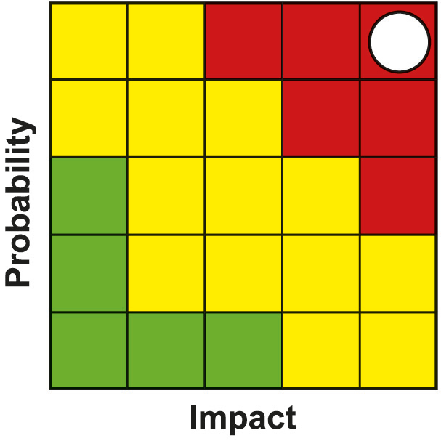
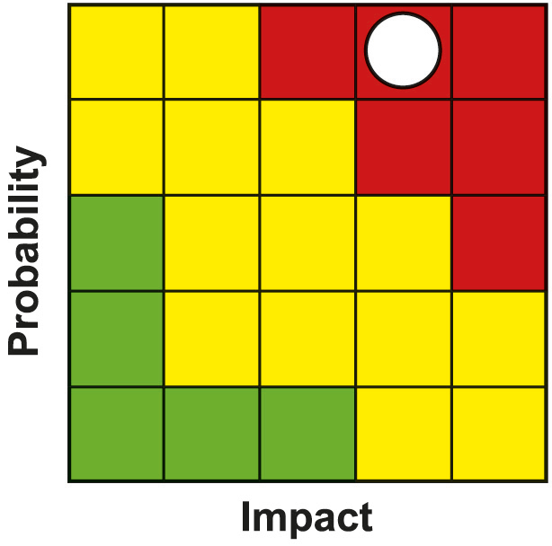
Programme Risk Register
PMO lead Clare Slater, Project Manager
PMO lead Clare Slater, Project Manager
Risk | Impact | Likelihood | Severity | Resolution Plan or Mitigating Action
Global Supply Chain Issues. Combined effect of Brexit / Covid / Ukraine Conflict | 5 | 5 | 25 | Projects are indicating less impact on staff resources, but significant impacts on availability and cost of materials. PMO working with SG, UKG, SE and Projects to understand supply chain exposures and contingency plans. Monitoring of impacts on project costs / tenders received through regular updating of progress report and monthly financial forecasts and feedback to the partnership and Governments. Impacts on outputs & benefits of individual projects as a result of inflationary increases to be managed through the agreed change control process. None indicated at this time. Scottish Enterprise (SE) leading on behalf of the Partnership work to understand supply chain exposures and contingency plans, with a workshop proposed. S.E. have shared a Brexit Exposure tool.
Programme Management | 5 | 4 | 20 | A number of projects have incurred underspends against their awarded drawdown profiles. All underspend is be in ‘year 10’ at the Project Owners risk. Due to inflationary pressures, there is a risk that awards to projects later in the Deal may represent less value for money and has the potential to impact on the deliverables for each project. The severity of the risk has increased. A number of projects are indicating increased construction costs. Many have indicated they have had to address this through Value Engineering which has highlighted potential risks to outputs and benefits. The PMO will monitor this through the Project Owner meetings.

Slide 11
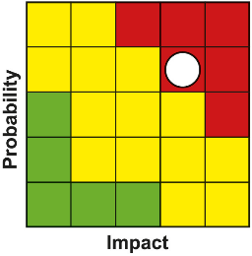
Programme Risk Register
PMO lead Clare Slater, Project Manager
Risk | Impact | Likelihood | Severity | Resolution Plan or Mitigating Action
PMO resource and capacity issues | 4 | 4 | 16 | Taking staff time to be trained will put PMO capacity under pressure and for at least 6 months after recruitment. New Project Manager in Team, however it resulted in loss of Project Officer. Loss of PMO administrator/coordinator through retirement. More permanent contracts being considered in line with other Deal PMO’s and partners. Project Officer role now has to be re-advertised.
Delays in development and approval of business cases | 4 | 4 | 16 | PMO working closely with project leads and policy leads within UKG and SG to support business case development and approval to an agreed timeline. Issues e.g. project capacity & Covid-19 to be raised through governance. Programme of Outreach and Virtual events outlining governance timescales to mitigate delays in development with projects; Regular meetings with projects have been set up to keep regular contact with projects. Regular programme monitoring and reporting.
Failure to deliver individual projects within the TCD programme | 4 | 4 | 16 | Regular dialogue/reporting around progress takes place between PMO and Project Leads where issues are raised in advance and, if appropriate, escalated to Government & Partnership Programme Management reporting in place. Regular meetings with year 3 and 4 projects have been set up to keep regular contact with projects. Management Group and other governance arrangements in place to monitor project development. PMO will escalate any issues relating to individual projects through existing governance arrangements

Slide 12
@taycities www.taycities.co.uk

