Slide 1
Tay Cities Deal: TCD008
Low Carbon Transport & Active Travel Hubs Programme
Perth & Kinross Council

Slide 2
Low Carbon Transport & Active Travel Hubs Programme
Programme Purpose: To broaden the range of sustainable travel choices available to residents, workers and visitors to the region and to improve sustainable connectivity, workforce mobility and innovation.
TCD Funding Ask - £3.5m
Three Phase TCD Programme: Low Carbon Transport & Active Travel Hubs
Phase 1 – Broxden - Low Carbon Transport Hub (Broxden Park & Ride – £1.06m – 2022)
Phase 2 – Perth – Active Travel Hubs (Perth City – £1.263m – 2024-26)
Phase 3 – Perth – Hydrogen Refuelling Station (Tibbermore Junction – £1.6m – 2027-29)

Slide 3
Low Carbon Transport & Active Travel Hubs Programme
Strategic Objectives: Phase 1 - Broxden-Low Carbon Transport Hub – To sustainably support and promote the uptake of Electric Vehicles
SO1 - To provide easily accessible low carbon EV charging infrastructure and to increase the usage of low carbon EV charging infrastructure at the Broxden Park & Ride site by 100% from baseline (2022) by 2027.
SO2 – To utilise at least 90% of the on-site generated renewable energy in support of the EV charging systems at the site per year.
SO6 – To Increase awareness of the low carbon infrastructure and facilities by 50% from baseline (2022) by 2027.

Slide 4
Low Carbon Transport & Active Travel Hubs Programme
Phase 1 – Project Benefits
B1 – Support the uptake of Electric Vehicles through the increased provision of EV charging facilities and contribute towards meeting the Scottish Government climate change targets (phasing out of the need for new petrol and diesel cars and vans by 2030). Relating to SO1
B4 - Reduction in the use of grid energy. Relating to SO2
B5 - Reduction in the cost of energy to support EV chargers. Relating to SO2
B7 – Improvement in the knowledge and awareness of low carbon infrastructure, facilities and travel options. Relating to SO1 & SO6
B8 – Jobs – 2.5 FTE Construction Jobs & 1.5 FTE retained/safeguarded

Slide 5
Low Carbon Transport & Active Travel Hubs Programme
Phase 1 – Broxden – Low Carbon Transport Hub project - £1.06m (ERDF/TCD)
Funding: ERDF (Secured) - £424k – Matched funding (40%); TCD (Requested) - £636k
Project Outputs:
Expansion of EV Charging Stations – 41 EV Charging spaces + 2 E-bike Chargers
Sustainable support for EV Chargers – Solar Carports & Battery systems
Smart Energy Management – to maximise the use of on-site generated renewable energy and optimise energy usage in support of the EV chargers
Private Bike storage
Transport Information Display unit
Project Delivery - 2022
Location – Broxden Park & Ride (Close to M90/A9 interchange on the western edge of Perth)

Slide 6
Low Carbon Transport & Active Travel Hubs Programme Phase 1 – Broxden Park and Ride Location
Broxden Park & Ride site

Slide 7
Low Carbon Transport & Active Travel Hubs Programme
Transport Information Display
Disabled Access EV Charger
Solar Canopy
Bike Storage & E-Bike chargers
Battery Storage & Smart Energy Management system
Expansion of EV Chargers

Slide 8
Low Carbon Transport & Active Travel Hubs Programme
Phase 1: Broxden – Low Carbon Transport Hub – Carbon Impact
Total Embodied & Operational Carbon Costs for Phase 1 - Broxden-LCTH 2022-26:
Low - 579.8 tCO2e; Predicted - 614.8 tCO2e; High - 650 tCO2e
Total carbon costs Broxden-LCTH phase 1:
Low - £144,238; Predicted - £153,357; High - £162,722
Total Carbon Savings for Phase 1 - Broxden-LCTH 2022-26:
Low - 6,679 tCO2e; Predicted - 8,906 tCO2e; High - 11,144 tCO2e
Total Carbon savings Broxden-LCTH phase 1:
Low - £1,735,209; Predicted - £2,313,630; High - £2,894,974

Slide 9
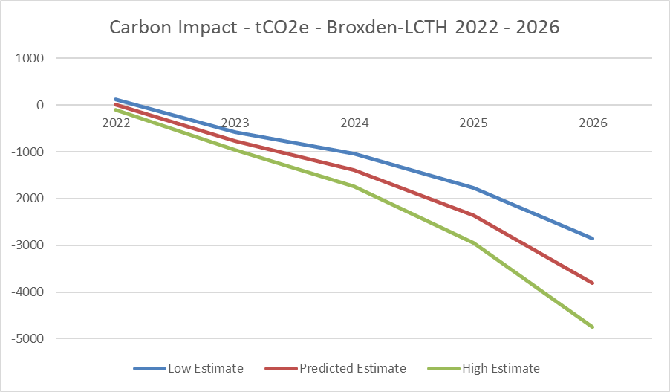
Low Carbon Transport & Active Travel Hubs Programme
Phase 1: Broxden – Low Carbon Transport Hub – Carbon Impact

Slide 10
Low Carbon Transport & Active Travel Hubs Programme
Phase 2 – Perth – Active Travel Hubs - To provide Active Travel alternatives to using private cars and to improve the sustainable mobility of non-car owners.
To be coordinated and delivered with the Sustrans project – Perth, People, Place – (£400k for Concept Design plus a potential £6m on approval of this design)
Full Business Case to be developed in coordination with the Sustrans, Perth, People, Place project
Phase 2 – Strategic Objectives
SO3 - Improve the mobility of non-car owners and providing credible low carbon alternatives for car owners by increasing bike hire usage by 50%, increase car club usage by 50%, increase usage of MaaS app by 50% from baseline (2025) by 2030.
SO4 – Contribute towards the improved health and well-being of citizens by increasing bike hire usage by 50%, increase in path usage by 50% from baseline (2025) by 2030.
Project Delivery – 2024 - 2026 Location - Perth City

Slide 11
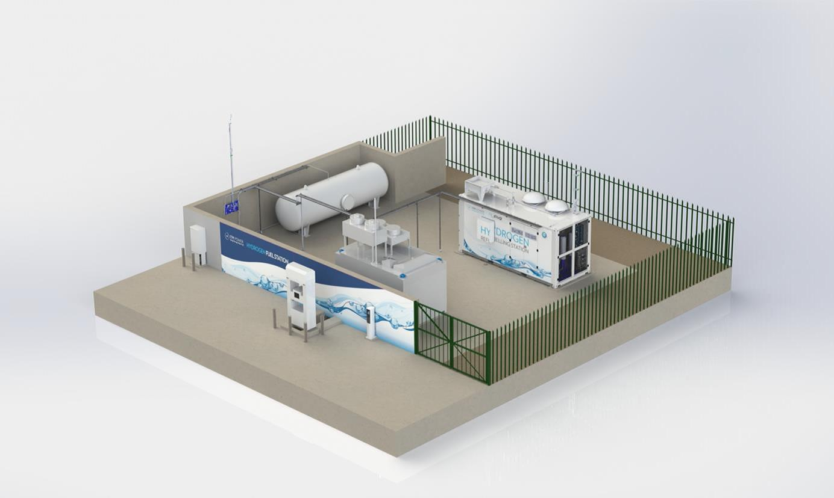
Low Carbon Transport & Active Travel Hubs Programme
Phase 3 – Perth-HRS - To support and promote the uptake of hydrogen vehicles.
Phase 3 - Strategic Objectives:
SO5 - To increase the usage of low carbon hydrogen refuelling infrastructure by 50% from baseline (2029) by 2034.
Full Business Case to be developed and informed by Feasibility study in 2025.
Location – New Tibbermore Junction (nr Broxden)
Project Delivery – 2027 - 2029
H2 Storage
H2 Electrolyser
H2 Compressor
H2 Dispensing – 350 & 700 bar

Slide 12
Low Carbon Transport & Active Travel Hubs Programme
Michael Figures – Programme/Project Lead
MFigures@pkc.gov.uk
Thank You!

