Slide 1
Tay Cities Region Deal Joint Committee PMO Update 23rd September 2022

Slide 2
Deal Programme Timetable
Activity | Aug 2022 | Sep 2022 Joint Committee | Oct 2022 | Nov 2022 | Dec 2022 Joint Committee | Jan 2023 | Feb 2023 | Mar 2023 Joint Committee
Quarterly Performance Report – financial forecasting and risks |  | 30th Sept 2022 | Meeting with Governments |  | 31st December 2022 | Meeting with Governments |  | 31st March 2023
Term Forecast – Q2 and Q4 Grant Offer Letter requirement | 31st August 2022 |  |  |  |  |  | 28th February 2023
Benefits Realisation Plan – continued liaison with all projects to develop Logic Chain Models and Q2/Q4 reporting |  | 30th Sept 2022 reporting |  |  |  |  |  | 31st March 2023 reporting
Annual Performance Report – draft report to be developed ahead of December submission |  | 30th Sept 2022 drafting |  |  | 15th Dec 2022 submission |  |  | Final Report & Publication
Governance/Thematic Board review |  | September 2022
Annual Conversation |  |  |  |  |  |  | February 2023
Regional Collaboration Showcase Day with Governments – to follow up on the Annual Conversation |  |  |  | 4th November
Project Owner Events – events to update Project/Programme Owners on key messages and activities |  |  |  |  |  | Just 5 Min Event TBC January 2023
Scottish PMO Networking Group – Chair and secretariat provided by Tay Cities | Network Meeting 31st August |  | Network Meeting 26th October |  | Network Meeting 14th December |  | TBC February 2023

Slide 3
Capital Business Cases with Joint Committee Approval
Programme / Fund / Project Reference and Name | Approved by Govts | Approval by Joint Committee
TCD014 Eden Campus | 03/09/2020 | 21/08/2020
TCD021 Regional Culture and Tourism Investment Programme | 08/04/2020 | 19/06/2020
TCD021 (a) Hospitalfield | Not required | 17/07/2020
TCD016 Growing the Tay Cities Biomedical Cluster | 20/11/2020 | 19/02/2021
TDC012 Angus Fund | 24/09/2020 | 19/02/2021
TCD010 Advanced Plant Growth Centre | 10/03/2021 | 19/03/2021
TCD011 International Barley Hub | 10/03/2021 | 19/03/2021
TCD017 Perth Cultural Transformation (City Hall) | 17/02/2021 | 19/03/2021
TCD021 (b) Discovery Point | Not required | 23/04/2021
TCD013 cyberQuarter | 24/05/2021 | 18/06/2021
TCD005 & TCD006 Rural Angus and Rural Perth and Kinross Highspeed Broadband | 13/05/2021 | 18/06/2021
TCD007 5G Digital Testbeds | 21/12/2021 | 17/09/2021
TCD029 Stretch Dome Simulator | 26/08/2021 | 10/12/2021
TCD025 Tay Cities Engineering Partnership | 15/02/2022 | 11/03/2022
TCD008 Low Carbon Transport & Active Travel Hubs Programme | 25/02/2022 | 01/07/2022
TCD008 Low Carbon Transport: Phase 1 Broxden | 06/06/2022 | 01/07/2022

Slide 4
Revenue Business Cases with Joint Committee Approval
Programme / Fund / Project Reference and Name | Approved by Govts | Approval by Joint Committee
TCD002 Dundee Airport Investment (Revenue) | 12/11/2020 | 19/02/2021
TCD024 Regional Skills & Employability Development Programme | 26/01/2022 | 11/03/2022
TCD024(a) Skills Programme Manager Post | 26/01/2022 | 11/03/2022
TCD025 Tay Cities Engineering Partnership | 15/02/2022 | 11/03/2022

Slide 5
Business Cases with Government Approval
There is a commitment in the Deal Document to inform the Joint Committee when the Management Group and Governments approve an Outline Business Case (OBC)
For the period of July to September 2022, 1 business case has been approved
Programme / Fund / Project Reference and Name | Approved by Thematic Board | Approval by Governments | Approval by Management Group
TCD027 Aero Space Kinross | 11/07/2022 | 08/08/2022 | 25/08/2022

Slide 6
Year 3 Business Case Timetable - Capital
Programme / Fund / Project | Sep 2022 Joint Committee | Oct 2022 | Nov 2022 | Dec 2022 Joint Committee | Jan 2023 | Feb 2023 | Mar 2023 Joint Committee
Centre for Agricultural Sustainable Innovation (CASI) Programme (Angus Fund) |  |  | Programme OBC to MG | Programme OBC to JC
CASI Programme CASI HQ Project (Angus Fund) |  |  |  |  |  | BJC to MG | BJC to JC
CASI Programme Crop Quality Centre Project (Angus Fund) |  |  | OBC to MG |  |  | FBC to MG | FBC to JC
Mercury Drone Port Project (Angus Fund) |  |  | BJC to MG | BJC to JC
Angus Rural Mobility Hub Project (Angus Fund) |  |  | OBC to MG |  |  | FBC to MG | FBC to JC
Regional Culture and Tourism Investment Programme Refresh |  |  |  |  |  | OBC refresh to MG | OBC refresh to JC
Perth Innovation Highway (Year 4 Project) |  |  |  |  |  |  | OBC to MG
Pitlochry Festival Theatre (Year 6 Project) |  |  |  |  |  | FBC to MG | FBC to JC
Aero Space Kinross (Year 9 Project) |  |  |  |  |  | FBC to MG | FBC to JC

Slide 7
Year 3 Business Case Timetable - Revenue
Programme / Fund / Project | Aug 2022 | Sep 2022 Joint Committee | Oct 2022 | Nov 2022 | Dec 2022 Joint Committee | Jan 2023 | Feb 2023 | Mar 2023 Joint Committee
Regional Skills & Employability Development Programme Refresh |  |  |  | Programme refresh to MG | Programme refresh to JC
Digital Skills Revenue (Tay Cities Skills and Employability Development Programme) |  |  |  | BJC to MG | BJC to JC
Life Sciences (Tay Cities Skills and Employability Development Programme) |  |  |  | BJC to MG | BJC to JC
Supporting SME Skills (Tay Cities Skills and Employability Development Programme) |  |  |  | OBC to MG |  |  | FBC to MG | FBC to JC
Hospitality (Tay Cities Skills and Employability Development Programme) |  |  |  | BJC to MG | BJC to JC

Slide 8
Year 3 Capital & Revenue Programme
Headlines:
Capital
The total Capital profile for 22/23 for the Partnership within the Grant Officer letter is £37.32m.
A potential forecast underspend of £747k was reported in the July Monthly Report.
It is considered that this value can be managed within the overall Capital Deal Programme.
Revenue
The Year 3 Revenue profile within the Grant Offer letter is £1.01m.
In the July Monthly Report, Projects forecasted that they are on track to drawdown the allocated revenue funding.

Slide 9
Inflationary Projects
Headlines:
Work continues to be on going through regular meetings with Project Owners to understand the impacts of inflation
The position by both governments remains the same as reported in July
An update will be provided as the impact is understood in more detail

Slide 10
Change Control Requests
Programme / Fund / Project | Thematic Board | Govts | Status | Commentary
Tay Cities Engineering Partnership | 16/08/22 | 04/08/22 | Agreed | Change of governance structure for the project. The original proposal was for a Community Interest Company. Following legal advise, it will now be a Partnership agreement/Memorandum of Understanding.
Comic Centre | Informed 20/07/22 | Informed 20/07/22 | Informed | Change of organisation/project owner for the Comic Centre from West Ward Works to Dundee Heritage Trust.
Rural Broadband | 22/09/22 | 11/08/22 | Agreed | Variation to value of leverage committed to be secured from £5.9m to £3.9m. This is a reduction of £2m.
5G Digital Testbeds | 17/08/22 | 04/08/22 | Agreed | Change of use case trials for the Project. Use case trials were developed based on opportunities and Partner availability at the time the business case was drafted. The pandemic and economic factors have impacted on the availability and capacity of certain Partners to continue. The use cases have been updated and adapted so that they align with the same areas and deliver the same outputs.

Slide 11
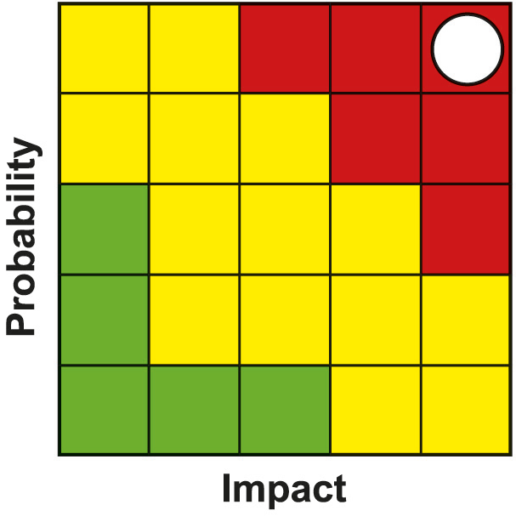
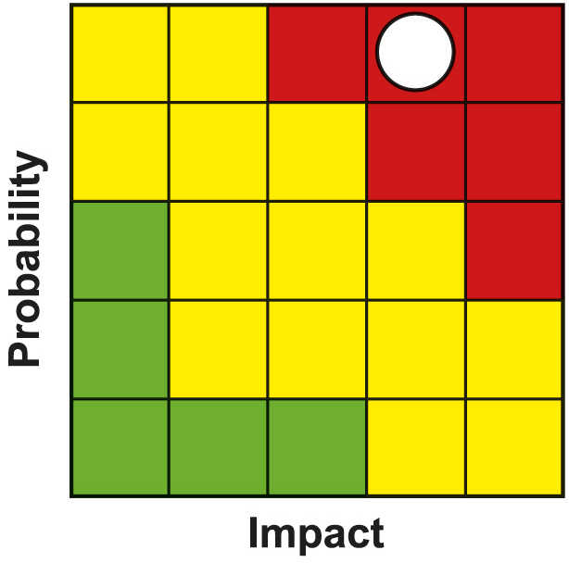
Programme Risk Register
PMO lead Clare Slater, Project Manager
PMO lead Clare Slater, Project Manager
Risk | Impact | Likelihood | Severity | Resolution Plan or Mitigating Action
Global Supply Chain Issues. Combined effect of Brexit / Covid / Ukraine Conflict | 5 | 5 | 25 | Projects are indicating less impact on staff resources, but significant impacts on availability and cost of materials. PMO working with SG, UKG, SE and Projects to understand supply chain exposures and contingency plans. Monitoring of impacts on project costs / tenders received through regular updating of progress report and monthly financial forecasts and feedback to the partnership and Governments. Impacts on outputs & benefits of individual projects as a result of inflationary increases to be managed through the agreed change control process. None indicated at this time. Scottish Enterprise (SE) leading on behalf of the Partnership work to understand supply chain exposures and contingency plans, with a workshop proposed. Date TBC
Programme Management | 5 | 4 | 20 | A number of projects have incurred underspends against their awarded drawdown profiles. All underspend is be in ‘year 10’ at the Project Owners risk. Due to inflationary pressures, there is a risk that awards to projects later in the Deal may represent less value for money and has the potential to impact on the deliverables for each project. The severity of the risk has increased. A number of projects are indicating increased construction costs. Many have indicated they have had to address this through Value Engineering which has highlighted potential risks to outputs and benefits. The PMO will monitor this through the Project Owner meetings.

Slide 12
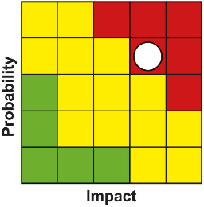
Programme Risk Register
PMO lead Clare Slater, Project Manager
Risk | Impact | Likelihood | Severity | Resolution Plan or Mitigating Action
PMO resource and capacity issues | 4 | 4 | 16 | Time for training will put PMO capacity under pressure and for at least 6 months after recruitment. There are currently 2 vacancies in the PMO. The Project Officer role will need to be readvertised. More permanent contracts being considered in line with other Deal PMO’s and Partners. Due to vacancies within the Team there will be reduced capacity within the PMO.
Delays in development and approval of business cases | 4 | 4 | 16 | PMO working closely with project and policy leads within UKG and SG to support business case development and approval to an agreed timeline. Issues e.g. project capacity & Covid-19 to be raised through governance. Programme of Outreach and Virtual events outlining governance timescales to mitigate delays in development with projects; Regular meetings with projects have been set up to keep regular contact with projects. Regular programme monitoring and reporting.
Failure to deliver individual projects within the TCD programme | 4 | 4 | 16 | Regular dialogue/reporting around progress takes place between PMO and Project Leads where issues are raised in advance and, if appropriate, escalated to Government & Partnership Programme Management reporting in place. Regular meetings with year 3 and 4 projects have been set up to keep regular contact with projects. MG and other governance arrangements in place to monitor project development. PMO will escalate any issues relating to individual projects through existing governance arrangements.

Slide 13
@taycities www.taycities.co.uk

