Slide 1
Digital Skills Project
Morag Millar
Fife Council, Strategic Growth & City Deals Programme Manager
December 2022

Slide 2
Consultation – with employers and providers
From an employer perspective
“all the provision seems very similar and it’s hard to wade through this to work out what is appropriate for our staff. Better signposting is required to help match the individual to the right course for them and their career aspirations”.
“The time to deliver these courses is too long – even weeks is too long to release staff members from their duties.”
“ We don’t know enough about adult learners’ barriers and motivations”.

Slide 3
Objectives
3 Business Needs and Service Requirements that must be met:
plugging the digital skills gap,
understanding/satisfying business needs and
creating unrivalled talent.
By real change in digital skills system in the region.
By delivering new, pilot approaches and enablers for digital skills - to deliver a step-change in performance and inclusion.

Slide 4
Scope
Not basic digital skills for the general workforce. Embedded within No One Left Behind delivery.
Intermediate, advanced, and professional digital technology skills – not just for the technology sector but for all other sectors. Every business is a digital business
Businesses who produce tech and those who use it.

Slide 5
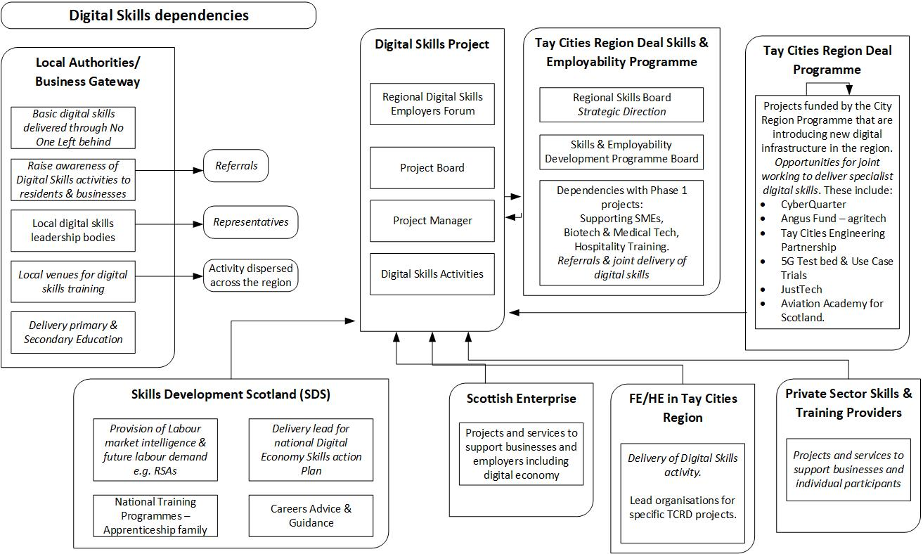

Slide 6
Deliver by March 2025
A Digital Skills Pipeline for the Region, beginning to close the skills gaps in the Digital Economy.
Regional Digital Skills Leadership Forum.
Projects delivered to address digital/data skills needs, take advantage of opportunities as they arise, and support the region’s digital economy.
Increase opportunities for specialist roles within Digital and Creative Industries across the region AND in other sectors also demanding digital skills in their workforce.

Slide 7
Outcomes
By the end of Year 3 (31 March 2025),
over 180 individuals (30% of the total for the whole project) supported directly or indirectly through the activities
60 delivery partners (30% of the total for the whole project) involved from all sectors (business, public sector, education etc.).
50% of the beneficiaries to be female, 4% BME and 10% disabled in line with the targets for the Regional Skills and Employability Development Programme.

