Slide 1
Digital Thematic Board - Update
Robin Presswood – Chair, Digital Thematic Board

Slide 2
Governance
1-2 representatives from each LA
Scottish Enterprise
Scottish Futures Trust
Membership highlights increasing focus on digital infrastructure and regional digital economy

Slide 3
Digital Board Business Cases
Project Reference and Name
TCD005 & TCD006 Rural Angus and Perth & Kinross Broadband
TCD007 5G Digital Testbeds
TCD005 & TCD006 – Deployment complete as of 31st March 2022. 186 sites connected in Perth & Kinross and Angus.
TCD007
Governance process in place with established Tay5G Board for oversight of project development and delivery
Pathfinder delivered - eSports
Pathfinders in progress - Virtual Production and Smart Ports
Tay5G Challenge Fund – Launched for applications on 7th December - funded projects to commence in April 2023.

Slide 4
Digital Infrastructure – Fixed and Mobile
Key area of focus following on from completion of Rural Angus and Perth & Kinross Broadband
What are the gaps to gigabit/full-fibre deployment across Tay Cities Region?
SG R100 Programme – Timescales and understanding gaps in main programme
Mobile deployment – anticipating and stimulating demand for 5G & Small Cell

Slide 5
Substantial programme of engagement with digital infrastructure providers active in the Tay Cities Region, including:
Key Goals:
Understanding current and future deployment plans
Barriers to deployment
Utilisation of Broadband Voucher Schemes (R100, UKG)

Slide 6
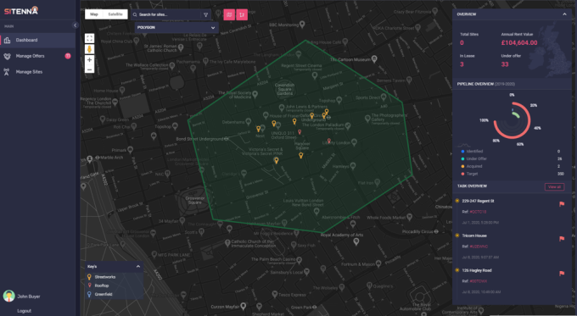
Scottish Futures Trust - Infralink
Tay Cities Region working with SFT to implement best practice in mobile infrastructure deployment
DCMS-funded pilot – Infralink Exchange – online asset registry to assist Mobile Network Operators (MNOs) in siting masts
Platform currently in testing - Running to March 2023
Goals:
Accelerate deployment (inc. 5G Small Cell)
Reduce time from proposal-to-deployment
Increase collaboration with Industry

Slide 7
Digital Economy
Scottish Enterprise – Regional Digital/Tech Ecosystems– Draft Report circulated for feedback
Barriers – lack of tech accelerators or colocation spaces in region, investor presence focused on central belt, regular tech events
Opportunities – Launch of Tech Scaler and CyberQuarter
Final Report in new year - working with SE to identify next steps

Slide 8
Looking Forward
Adding further National Agency expertise to the Board.
Reflecting broader scope of activities
TCD Digital Skills Project
Identifying opportunities for collaboration
SE’s Regional Digital/Tech Ecosystem work will be critical

Slide 9
Looking Forward – Digital Infrastructure
Creation of a Regional Digital Infrastructure Strategy
Maximise fibre and mobile deployment throughout region
Removing barriers to commercial rollout
Support growing knowledge economy and create a demand for digital skills
UK SPF Proposal – Digital Engagement Officers
Take-up of R100 vouchers remains low – high risk of digital exclusion – 11k+ premises eligible
Regional posts – engaging with suppliers and residents to maximise take-up of vouchers across Tay Cities Region

Slide 10
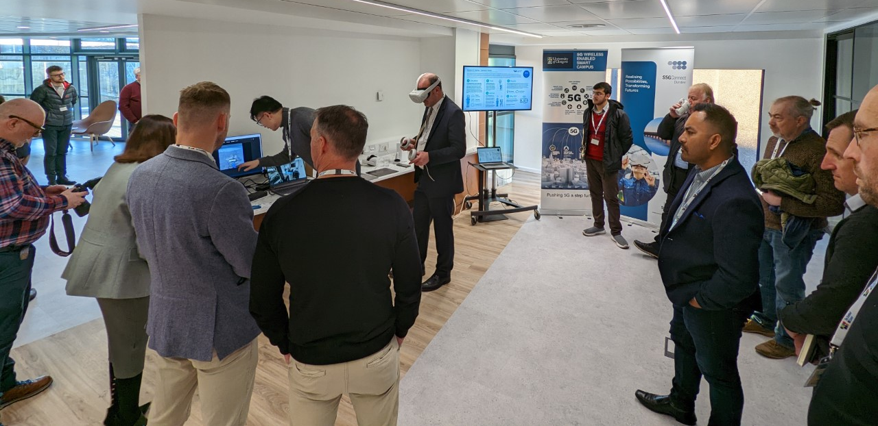
Looking Forward – 5G
Tay 5G
Virtual Production and Smart Ports Use Cases
Tay5G Challenge Fund – Launched for applications on 7th December
All Funded projects to commence on 1st April 2023 and will be complete by 31st March 2024.
Launch of Regional S5GCConnect Hub in Dundee on 6th December

