Slide 1
Tay Cities Region Deal Joint Committee PMO Update 9th December 2022

Slide 2
Deal Programme Timetable
Activity | Nov 2022 | Dec 2022 Joint Committee | Jan 2023 | Feb 2023 | Mar 2023 Joint Committee | Apr 2023 | May 2023 | Jun 2023
Quarterly Performance Report – financial forecasting and risks |  | 31st December | Meeting with Governments |  | 31st March | Meeting with Governments |  | 30th June
Term Forecast – Q2 and Q4 Grant Offer Letter requirement |  |  |  | 28th February
Benefits Realisation Plan –Q2/Q4 reporting |  |  |  |  | 31st March reporting
Annual Performance Report to Governments |  | 15th Dec draft submission |  |  | Final Report & Publication
Annual Conversation |  |  |  | 3rd February
Implementation Plan annual review commitment |  |  |  |  |  |  |  | 30th June
Regional Collaboration Day with Governments – to follow up on the Annual Conversation, held February 2022 | 4th November
Governance/Thematic Board review | 24th November
Project Owner Events – events to update Project/Programme Owners on key messages and activities |  |  | Project Owners Event TBC |  |  | Just 5 Min Event TBC
Scottish PMO Networking Group – Chair and secretariat provided by Tay Cities PMO |  | 14th December |  | 8th February |  | 5th April | 31st May

Slide 3
Capital Business Cases with Joint Committee Approval
Programme / Fund / Project Reference and Name | Approved by Govts | Approval by Joint Committee
TCD014 Eden Campus | 03/09/2020 | 21/08/2020
TCD021 Regional Culture and Tourism Investment Programme | 08/04/2020 | 19/06/2020
TCD021 (a) Hospitalfield | Not required | 17/07/2020
TCD016 Growing the Tay Cities Biomedical Cluster | 20/11/2020 | 19/02/2021
TDC012 Angus Fund | 24/09/2020 | 19/02/2021
TCD010 Advanced Plant Growth Centre | 10/03/2021 | 19/03/2021
TCD011 International Barley Hub | 10/03/2021 | 19/03/2021
TCD017 Perth Cultural Transformation (City Hall) | 17/02/2021 | 19/03/2021
TCD021 (b) Discovery Point | Not required | 23/04/2021
TCD013 cyberQuarter | 24/05/2021 | 18/06/2021
TCD005 & TCD006 Rural Angus and Rural Perth and Kinross Highspeed Broadband | 13/05/2021 | 18/06/2021
TCD007 5G Digital Testbeds | 21/12/2021 | 17/09/2021
TCD029 Stretch Dome Simulator | 26/08/2021 | 10/12/2021
TCD025 Tay Cities Engineering Partnership | 15/02/2022 | 11/03/2022
TCD008 Low Carbon Transport & Active Travel Hubs Programme | 25/02/2022 | 01/07/2022
TCD008 Low Carbon Transport: Phase 1 Broxden | 06/06/2022 | 01/07/2022

Slide 4
Revenue Business Cases with Joint Committee Approval
Programme / Fund / Project Reference and Name | Approved by Govts | Approval by Joint Committee
TCD002 Dundee Airport Investment (Revenue) | 12/11/2020 | 19/02/2021
TCD024 Regional Skills & Employability Development Programme | 26/01/2022 | 11/03/2022
TCD024(a) Skills Programme Manager Post | 26/01/2022 | 11/03/2022
TCD025 Tay Cities Engineering Partnership | 15/02/2022 | 11/03/2022

Slide 5
Business Cases with Government Approval
There is a commitment in the Deal Document to inform the Joint Committee when the Management Group and Governments approve an Outline Business Case (OBC)
For the period of October to November, 1 Business Justification Case (BJC) has been agreed
This BJC is being presented to this December Joint Committee for consideration for approval
Programme / Fund / Project Reference and Name | Approved by Thematic Board | Approval by Governments | Approval by Management Group
TCD024 b Digital Skills | 25/10/2022 | 03/11/2022 | 24/11/2022

Slide 6
Business Case Risks
As a Partnership we are now in Year 3 of delivery.
All Projects and Programmes should be looking to develop and secure approval of business cases ahead of the financial year that they are profiled to drawdown.
In this current Year 3, £2.07m capital and £898k revenue¹ has not secured approval. This is a risk to both Project Owners and the Partnership.
For Year 4 Projects, there are currently 6 business cases that have not secured approval to the value of £4.337m capital and Phase 2 of the Skills Programme to the value of £753k revenue.
¹ Please note this figure includes the Digital Skills project being presented at this meeting.

Slide 7
Year 3 - 2022/23 Business Case Timetable - Capital
Updated 08/11/2022 based on Project Owner forecast
Programme / Fund / Project | Nov 2022 | Dec 2022 Joint Committee | Jan 2023 | Feb 2023 | Mar 2023 Joint Committee
Centre for Agricultural Sustainable Innovation (CASI) Programme (Angus Fund) (Year 3 Project) |  |  |  | Programme OBC to MG | Programme OBC to JC
Mercury Drone Port Project (Angus Fund) (Year 3 Project) |  |  |  | BJC to MG | BJC to JC
Angus Rural Mobility Hub Project (Angus Fund) (Year 3 Project) |  |  | OBC to MG | FBC to MG | FBC to JC
Perth Innovation Highway (Year 3 Project – confirmed no drawdown until Year 4) |  |  |  |  | OBC to MG
Advanced Manufacturing Programme (Year 5 Project) |  |  |  | Programme OBC to MG | Programme OBC to JC
Pitlochry Festival Theatre (Year 6 Project) |  |  |  | FBC to MG | FBC to JC
Aero Space Kinross (Year 9 Project) |  |  |  | FBC to MG | FBC to JC

Slide 8
Year 4 - 2023/24 Business Case Timetable - Capital
Updated 08/11/2022 based on Project Owner forecast
Programme / Fund / Project | Apr 2023 | May 2023 | Jun 2023 Joint Committee | Jul 2023 | Aug 2023 | Sep 2023 Joint Committee | Oct 2023 | Nov 2023 | Dec 2023 Joint Committee | Jan 2024 | Feb 2024 | Mar 2024 Joint Committee
Regional Culture and Tourism Investment Programme Refresh |  | OBC refresh to MG | OBC refresh to JC
CASI HQ Project (Angus Fund) (Year 3) |  | BJC to MG | BJC to JC
Crop Quality Centre Project (Angus Fund) (Year 3) |  | OBC to MG |  |  | FBC to MG | FBC to JC
Perth Innovation Highway Project (Year 3 Project – confirmed no drawdown until Year 4) |  |  |  |  | FBC to MG | FBC to JC
Low Carbon Transport Phase 2 Project (Year 4 due to drawdown from mid-year) |  |  |  |  | FBC to MG | FBC to JC
Aviation Academy for Scotland (Year 3 Project – confirmed no drawdown until Year 4) |  |  |  |  |  |  |  |  |  |  | FBC to MG TBC | FBC to JC TBC
Regional Culture & Tourism Investment Projects – TBC (Year 4 & 5) |  |  |  |  |  |  |  |  |  |  | FBC to MG TBC | FBC to JC TBC
Just Tech (Year 5) |  |  |  | OBC to MG |  |  |  |  |  |  | FBC to MG TBC | FBC to JC TBC
Advanced Manufacturing Projects TBC (Year 5) |  |  |  |  |  |  |  |  |  |  | FBC to MG TBC | FBC to JC TBC

Slide 9
Year 3 Projects with Business Case Approval Forecasting Underspends
Headlines:
A total of £6.5m capital is forecast as underspend
In the Q2 Quarterly Report, Projects with business case approval reporting a forecast underspend at year end include:
There is £140k available due to Rural Broadband accelerating last year.
This is a change of an additional £5.801m from the September PMO presentation
Project | Forecast Underspend £000
Growing the Tay Cities Biomedical | 4,666
Advanced Plant Growth Centre | 982
International Barley Hub | 746
Low Carbon Transport Phase 1: Broxden | 154
Total | 6,548

Slide 10
Year 3 Capital Projects without Business Cases with Confirmed No Spend
Headlines:
The following Year 3 Capital Projects within the Grant Offer Letter, have now confirmed no drawdown this financial year against their awarded profile:
Project | Forecast Underspend £000 | Comment
Angus Fund, CASI HQ Project | 500 | Confirmed no drawdown due to business case approval delays 04/11/2022.
Angus Fund, CASI Crop Quality Centre Project | 770 | Confirmed no drawdown due to business case approval delays 04/11/2022.
Total | 1,270

Slide 11
Year 3 Capital Asks for Acceleration
Project | Value of ‘Ask’ £000 | BJC/FBC Approved at Joint Committee | Comment
Tay Cities Engineering Partnership | 197 | Yes | Request to accelerate from forecast year 10 underspend placement. The project have indicated that they wish to request acceleration of £197k. They have £211k sitting in year 10 (year 2 underspend). This would leave £14k in year 10. The project are not able to spend until confirmation is received.
Eden Campus | 1,520 | Yes | Request to accelerate from forecast year 10 underspend placement. The project have indicated that this wish to request their forecast underspend of £1.49m from year 2 and acceleration of £30k currently profiled for year 10, in year 3 in addition to their year 3 awarded profile (total of £1.52m). The project is currently on track to drawdown their allocation by the end of Q3. Seeking confirmation that the project are looking to complete the Spine Road.
cyberQuarter | 50 | Yes | Request to accelerate from forecast year 10 underspend placement. The project have indicated that they wish to request acceleration of funds of £50k. There is also the potential that the project will have additional expenditure this financial year that they may ask to accelerate.
Hospitalfield | 669 | Yes | Request to acceleration from forecast year 10 underspend placement. Hospitalfield have indicated an ask of £954k for Phase 1 (which has JC approval). It was agreed that £285k from the C&T Programme could be allocated to the Project. Therefore they have a remaining ask of £669k which is currently being confirmed by the Project. The Project have indicated they can confirm by the end of November.
Total of ask from Projects with Joint Committee Business Case Approval | £2,436

Slide 12
Year End Headlines
Headlines:
Management Group have approved reallocation of £1.410m from the ‘Asks’ list, subject to the Projects confirming eligible expenditure before year end.
This leaves a current forecast Capital underspend of £5.14m
Email received from Karen McAvenue Scottish Government 17th November circulated to Management Group and Project Owners reinforcing the importance of accurate forecasting. Partners have been asked for their support in:
Providing accurate forecasting in Quarter 3 and monthly towards the end of the financial year
Highlighting and identifying any confirmed underspends as early as known

Slide 13
2022/23 Business Case Timetable - Revenue
Programme / Fund / Project | Nov 2022 | Dec 2022 Joint Committee | Jan 2023 | Feb 2023 | Mar 2023 Joint Committee
Digital Skills Revenue (Tay Cities Skills and Employability Development Programme) (Year 3) | BJC to MG | BJC to JC
Life Sciences (Tay Cities Skills and Employability Development Programme) (Year 3) |  |  |  | BJC to MG | BJC to JC
Supporting SME Skills (Tay Cities Skills and Employability Development Programme) (Year 3) |  |  |  |  | OBC to MG

Slide 14
2023/24 Business Case Timetable - Revenue
Programme / Project | Apr 2023 | May 2023 | Jun 2023 Joint Committee | Jul 2023 | Aug 2023 | Sep 2023 Joint Committee | Oct 2023 | Nov 2023 | Dec 2023 Joint Committee | Jan 2024 | Feb 2024 | Mar 2024 Joint Committee
Regional Skills & Employability Development Programme Refresh |  | Prog. refresh to MG | Prog. refresh to JC
Supporting SME Skills (Tay Cities Skills and Employability Development Programme) (Year 3) |  | FBC to MG | FBC to JC
Hospitality (Tay Cities Skills and Employability Development Programme) (Year 3) |  | BJC to MG | BJC to JC
Pockets of Need & Skills Phase 2 Projects (Tay Cities Skills and Employability Development Programme) (Year 4) |  |  |  |  |  |  |  |  |  |  | FBC to MG TBC | FBC to JC TBC

Slide 15
Year 3 Projects Without Business Case Approval Forecasting Underspends
Headlines:
There are four Projects currently without Business Case approval within the Revenue Programme.
One Project, Digital Skills, is being presented to the Joint Committee for consideration and approval December. Three other Projects are forecasting an underspend at year end. These are:
Therefore £690k has been confirmed as a revenue underspend in 2022/23
Management Group agreed to report this formally to the Scottish Government
Project | Forecast Underspend £000
Life Sciences | 310
Supporting SME Skills | 300
Hospitality | 80
Total | 690

Slide 16
Change Control Requests
Programme / Fund / Project | Thematic Board | Govts | Status | Commentary
Tay Cities Engineering Partnership | 03/10/22 | Informed | Agreed | Jobs Commitment: Change from 1 FTE Project Manager post to 0.8 FTE post. The remaining 0.2FTE will be covered by the Senior Project Manager in place. The Project have highlighted that this will have no impact on the Project objectives.
Regional Skills & Employability Development Programme | 25/10/22 | 03/11/22 | Agreed | Change of Programme Ownership from SDS to Perth & Kinross Council. This has been agreed by the Skills Advisory Board and Governments.
Perth Innovation Highway | Informed 17/11/22 | Informed 17/11/22 | Accepted | Change of Project Ownership from John Dewar Lamburkin Trust to Perth & Kinross Council.
cyberQuarter | 11/11/22 | 11/11/22 | Pending | Change to scope of Project to the value of £5.073m - elements of the cloud computing and Pump Priming Fund as set out in the approved FBC are no longer able to be capitalised. Alternative options are set out in the change request.
Hospitalfield | Pending | Pending – shared for information only | Pending | Change to phases in the FBC. The change is from 3 – 5 phases however there is no change to the scope of the Project. The additional phases splits phase 1 in the approved business case to make tendering easier.
Hospitalfield | Pending | Pending – shared for information only | Pending | Request to inform Joint Committee at multiple times as match funding is received, to allow the Project to drawdown the next installment of TCRD funding (up to £2.5m in 2023/24). This is to allow the Project to progress without potential delays as a result of confirming all match funding has been received.

Slide 17
Audit Scotland
Email sent to all Local Authority Chief Executives – to inform them that they are carrying out an assessment of the impact of our 2020 Audit Scotland report on Scotland’s City Region and Growth Deals
This will assess progress against key 2020 recommendations, exploring if the recommendations have been implemented, the challenges and opportunities facing city deals and what learning can be shared.
A separate email sent out to all PMO’s with a survey to be completed. A Briefing Paper by Audit Scotland will be produced and published externally in due course.
A response was developed by the PMO and agreed by the Management Group.

Slide 18
Tay Cities Deal Internal Audit
Headlines:
Within the 2022 / 2023 Grant Offer Letter, there is an additional clause around the requirement for internal audit by the Accountable Body:
In addition to compliance with normal internal and external audit controls, the Tay Cities Deal should be subject to an audit, the focus of which will be determined by the Accountable Body’s Internal Audit Team. We would expect Tay Cities Deal to form part of the Accountable Body’s Risk Based Internal Audit Plan every second year as a minimum.
The audit must be carried out in line with Public Sector Internal Audit Standards (PSIAS) and the summary must also be submitted to the Scottish Government.
An audit will be conducted this year and is forecast to be presented to Dundee City Councils scrutiny committee in early spring

Slide 19
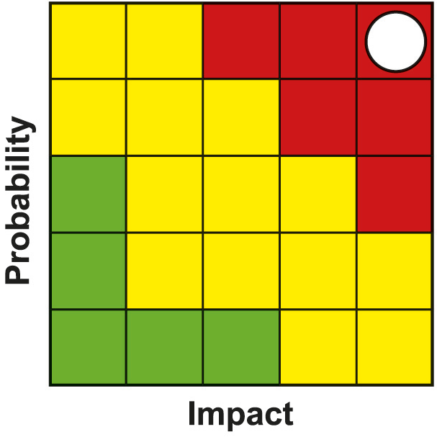
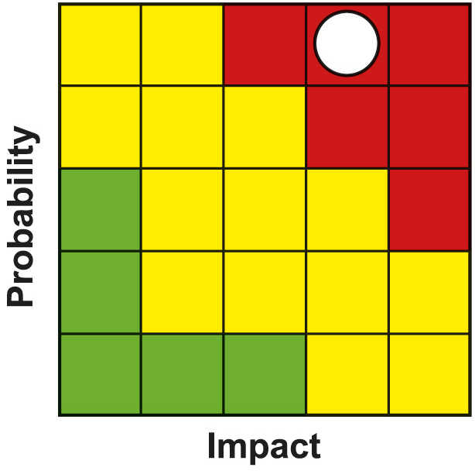
Programme Risk Register
PMO lead Clare Slater, Project Manager
PMO lead Clare Slater, Project Manager
Risk | Impact | Likelihood | Severity | Resolution Plan or Mitigating Action
Global Supply Chain Issues. Combined effect of Brexit / Covid / Ukraine Conflict | 5 | 5 | 25 | Projects are indicating less impact on staff resources, but significant impacts on availability and cost of materials. PMO working with SG, UKG, SE and Projects to understand supply chain exposures and contingency plans. Monitoring of impacts on project costs / tenders received through regular updating of progress report and monthly financial forecasts and feedback to the partnership and Governments. Impacts on outputs & benefits of individual projects as a result of inflationary increases to be managed through the agreed change control process. None indicated at this time. 2 projects are now indicating funding gap challenges. Both working towards addressing gap. Neither Project has formally reported being unable to deliver to their commitment.
Programme Management | 5 | 4 | 20 | A number of projects have incurred underspends against their awarded drawdown profiles. All underspend is be in ‘year 10’ at the Project Owners risk. Due to inflationary pressures, there is a risk that awards to projects later in the Deal may represent less value for money and has the potential to impact on the deliverables for each project. The severity of the risk has increased. A number of projects are indicating increased construction costs. Many have indicated they have had to address this through Value Engineering which has highlighted potential risks to outputs and benefits. The PMO will monitor this through the returns from Projects and Project Owner meetings.

Slide 20
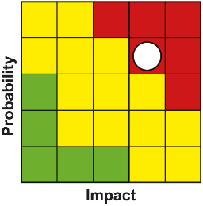
Programme Risk Register
PMO lead Clare Slater, Project Manager
Risk | Impact | Likelihood | Severity | Resolution Plan or Mitigating Action
PMO resource and capacity issues | 4 | 4 | 16 | Time for training will put PMO capacity under pressure and for at least 6 months after recruitment. There are currently 2 vacancies in the PMO. Temporary contracts are currently in place for the Project Manager roles and Project Offer role. Permanent contracts are being sought. Due to vacancies within the Team, there is reduced capacity within the PMO.
Delays in development and approval of business cases | 4 | 4 | 16 | PMO working closely with project and policy leads within UKG and SG to support business case development and approval to an agreed timeline. Issues e.g. project capacity & Covid-19 to be raised through governance. Programme of outreach and virtual events outlining governance timescales to mitigate delays in development with projects. Regular meetings with projects have been set up to keep regular contact with projects. Regular programme monitoring and reporting.
Failure to deliver individual projects within the TCD programme | 4 | 4 | 16 | Regular dialogue/reporting around progress takes place between PMO and Project Leads where issues are raised in advance and, if appropriate, escalated to Partnership and Governments Programme Management reporting in place. Regular meetings with year 3 and 4 projects have been set up to keep regular contact with projects. MG and other governance arrangements in place to monitor project development. PMO will escalate any issues relating to individual projects through existing governance arrangements.

Slide 21
@taycities www.taycities.co.uk

