Slide 1
Deal Programme Update Joint Committee 20th March 2026

Slide 2
Reshaping the Tay Cities Region Deal

Slide 3

Reshaping of the Deal Programme
A Reshaping approach was presented and agreed by Joint Committee Members in March 2025.
It includes a Timetable of activities that set out how the Reshaping work will be achieved.
There is a challenging level of work required over the next three months.
The continued efforts and support from all Partners will be key to achieve this.

Slide 4
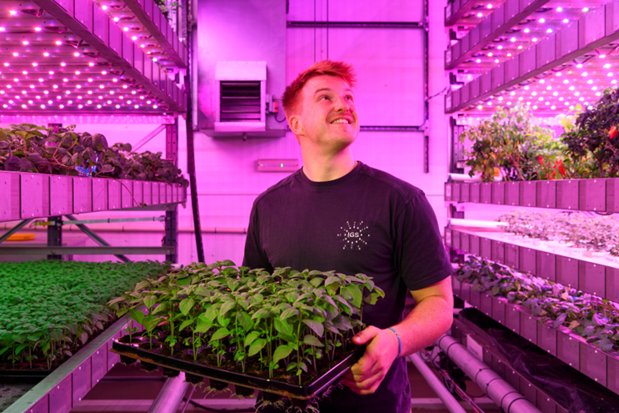
Review of Existing Deal Programme (Strand 1a and 1b)
Existing Programme Assurance
Panel meetings were held in November 2025 to review all the Assurances.
The Panel identified a number of actions for some of the Fund, Programme & Project Assurances.
The Panel requested that these were fully addressed no later than the 28th of February 2026.

Slide 5

Review of Existing Deal Programme (Strand 1a and 1b)
A review of all of the Assurances for the existing Programme is being undertaken in March 2026.
This will include the submissions on the actions identified by The Panel in November 2025.
Where actions have not been fully addressed the Fund/ Programme/ Project will be confirmed as not having provided sufficient Assurance.
It will be deemed that it cannot proceed, and the funding will be reallocated as part of the New Projects (Strand 2) work.

Slide 6

Review of Existing Deal Programme (Strand 1a and 1b)
This agreed approach will enable the Partners to understand and confirm:
full assurance on the Fund/Programmes and Projects that will remain in the Programme.
what the new Programme profile ‘asks’ will be and any risks that the Partnership will need to consider and address e.g. funding asks above the awarded tripartite profile.
the values of the funding and benefits that will no longer be proceeding to inform decision making for new Projects.

Slide 7
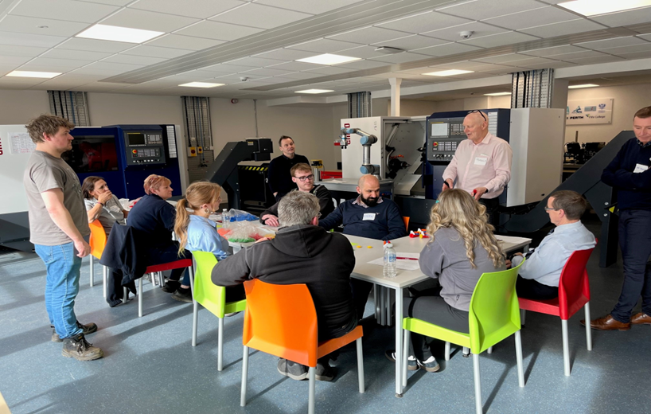
New Projects (Strand 2)
To enable the Partnership to be in the strongest position to reshape the Programme an open call for Projects was made in December 2025.
The call was placed on the Tay Cities Region Deal website.
All Projects will be required to complete an SOC and demonstrate
Deliverability;
Regional Economic Investment Impact; and
How they align with the Regional Economic Strategy & Prospectus.

Slide 8
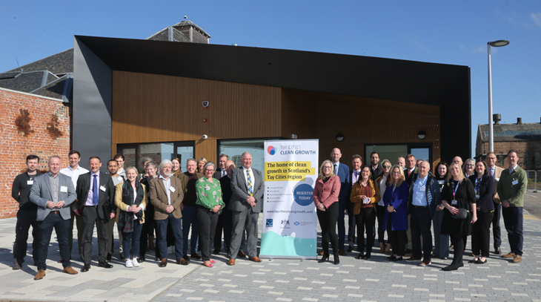
New Projects (Strand 2)
The deadline date for the SOC submissions is the 13th of March 2026.
An assessment of these is being undertaken in April 2026.
This work will inform any new Projects which are considered by the Partnership in the Reshaping of the Programme.
An update on the outcome of this work will be given to Joint Committee members at their meeting on the 19th of June.

Slide 9

New Projects (Strand 2)
This agreed approach will enable the Partners to have:
a list of new Project(s) that have demonstrated Assurance to the Partners that they meet the call for Project requirements.
a set of Project(s) to inform the Partnership discussions in the reshaping of the Deal Programme.

Slide 10
2025/26 Annual Conversation

Slide 11

Annual Conversation 2025/26
The Annual Conversation is for the UK & Scottish Governments’ Scottish City Region and Growth Deal Delivery Board to engage with each Deal at senior official level.
It is an opportunity to reflect, celebrate success and discuss any actions for both the Deal and Regional Collaboration.
The Annual Conversation is informed by the Annual Performance Report and the Annual Benefits Realisation Plan.
The Tay Cities Region Deal fifth Annual Conversation was held on Thursday 12th March 2026 at Perth Museum.

Slide 12
Delivery of Year 6 - 2025/26

Slide 13

Year 6 - Capital Programme Forecast
The Partnership requested a Capital Programme for Year 6, 2025/26 of £4.144m.
This was a reduction of £25.139m from the original awarded tripartite profile allocation of £29.283m.
Based on the 2026 February forecast, it is forecast that there will be a capital underspend of £2.364m, with no options to reallocate the funding.
There is £0.939m of capital still to drawdown in Q4, this is equivalent to 23% of the total capital allocation for 2025/26.

Slide 14
Year 6 - Revenue Programme Forecast
The Revenue Programme for Year 6 2025/26 was based on a request of £2.161m from partners.
This was a reduction of £351k from the original tripartite allocation awarded to the Partners of £2.512m.
The Skills Programme is forecasting an underspend of £0.23m (13% of the overall Skills Programme allocation).
Based on the 2026 February forecast, there is no total underspend predicated. This is due to an additional revenue award of £307k for Dundee Airport Investment Project.
There is £1.349m of revenue still to drawdown in Q4, this is equivalent to 62% of the revenue allocation for 2025/26.

Slide 15
Delivery of Year 7 - 2026/27

Slide 16

Year 7 Capital 'Ask' to Government
The Deal signed tripartite capital allocation for Year 7, 2026/27 is £29.658m.
The recommendation from the Finance Directors and Management Group is for the Partnership to make a request to Scottish Government for a capital allocation of £3.93m.
It was agreed that if a Project that does not currently have an approved business case, they will not be given an allocation for 2026/27.
The two exceptions to this, are Projects within the Regional Culture & Tourism Investment Programme, with a total ask of £653k.
This is £25.728m lower than the current government awarded profile.
This will be the third year that the Partnership will be requesting a reduction in their ‘ask’ against their annual capital award.

Slide 17
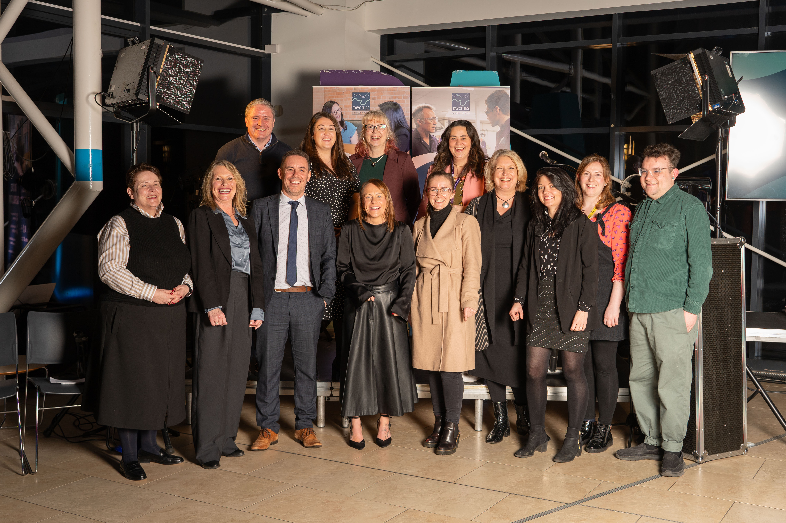
Year 7 Revenue 'Ask' to Government
The Deal signed tripartite revenue allocation for Year 7, 2026/27 is £2.339m.
The recommendation from the Finance Directors and Management Groups is for the Partnership to make a request to Scottish Government for a revenue allocation of £3.92m.
This is £1.518m increase above the current government awarded profile.
A request will therefore need to be made to the Scottish Government for the ‘ask’ of an additional £1.518m in Year 7.
There is no guarantee that funding above £2.339m will be available.

Slide 18
Information Updates

Slide 19

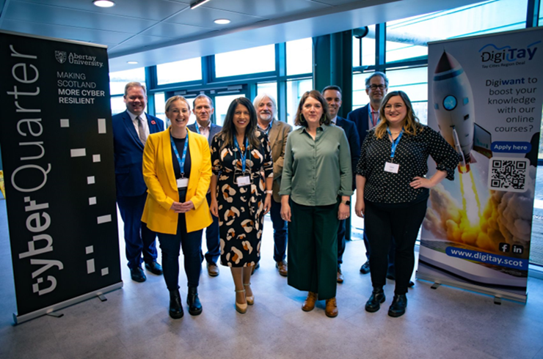
Business Cases with Government and Management Group Approval
There is a commitment in the Deal Document to inform the Joint Committee when the Management Group and Governments have approved a Strategic Outline Case (SOC) and Outline Business Case (OBC).
There have been no SOC or OBCs approved by Management Group since the last Joint Committee meeting.

Slide 20

Capital Business Cases with Joint Committee Approval since March 2023
Latest BJC/FBC approved by Joint Committee
The most recent Business Case to secure Joint Committee approval for a Capital Project was on the 23rd of June 2023.
The Partners have not had a Business Case approved at Joint Committee for
Programme / Fund / Project Reference and Name | Capital or Revenue | Approved by Govts | Approval by Joint Committee
TCD012 a Mercury Drone Ports (Angus Fund) | Capital | 14/03/2023 | 24/03/2023
TCD018 Pitlochry Festival Theatre | Capital | 06/02/2023 | 24/03/2023
TCD027 Aero Space Kinross (subject to conditions) | Capital | 15/02/2023 | 23/06/2023
For a full list of capital business cases with Joint Committee pre-March 2023, please view this additional slide

Slide 21
Revenue Business Cases with Joint Committee Approval
Latest BJC/FBC approved by Joint Committee
Programme / Fund / Project Reference and Name | Approved by Govts | Approval by Joint Committee
TCD002 Dundee Airport Investment (Revenue) (1) | 12/11/2020 | 19/02/2021
TCD024 Regional Skills & Employability Development Programme | 26/01/2022 | 11/03/2022
TCD024(a) Skills Programme Manager Post | 26/01/2022 | 11/03/2022
TCD025 Tay Cities Engineering Partnership | 15/02/2022 | 11/03/2022
TCD002 Dundee Airport Investment (Revenue) (2) | 06/03/2024 | 23/10/2023
TCD024(b) Digital Skills | 03/11/2022 | 09/12/2022
TCD024(c) Life Sciences: Biotechnology and Medical Technology | 20/11/2023 | 08/12/2023
TCD024(d) Supporting SME Skills | 12/10/2023 | 08/12/2023
TCD024 Regional Skills & Employability Development Programme Refresh | 13/06/2025 | 21/03/2025
TCD024(g) Sustainable Construction Skills | 31/07/2025 | 20/06/2025
TCD024(b) Digital Skills Phase 2 | 02/10/2025 | 03/10/2025
TCD002 Dundee Airport Investment (Revenue) (3) | 05/11/2025 | 03/10/2025
TCD024(e) Hospitality Skills | 10/10/2025 | 03/10/2025
TCD024(f) Targeting Hidden Talent Phase 1 | 20/11/2025 | 12/12/2025

Slide 22
@taycities www.taycities.co.uk

