Slide 1

Annual Performance Report Highlights
There is a Grant Offer Letter commitment for an Annual Performance Report.
This is the Partnership’s fifth Annual Report for the reporting period of October 2024 – September 2025.
It includes an updated financial statement for the Deal Programme, Project updates, new case studies including inclusive growth and carbon reductions.
It also includes jobs and leverage realised to date, as the Partnership completes its second full benefits reporting for Project’s in delivery.
The Annual Performance Report informed the Annual Conversation.
All parts of the Deal Governance have been consulted on the drafting of the Annual Report.
Angus Council Comms Team have supported the PMO in designing the Annual Performance Report.

Slide 2
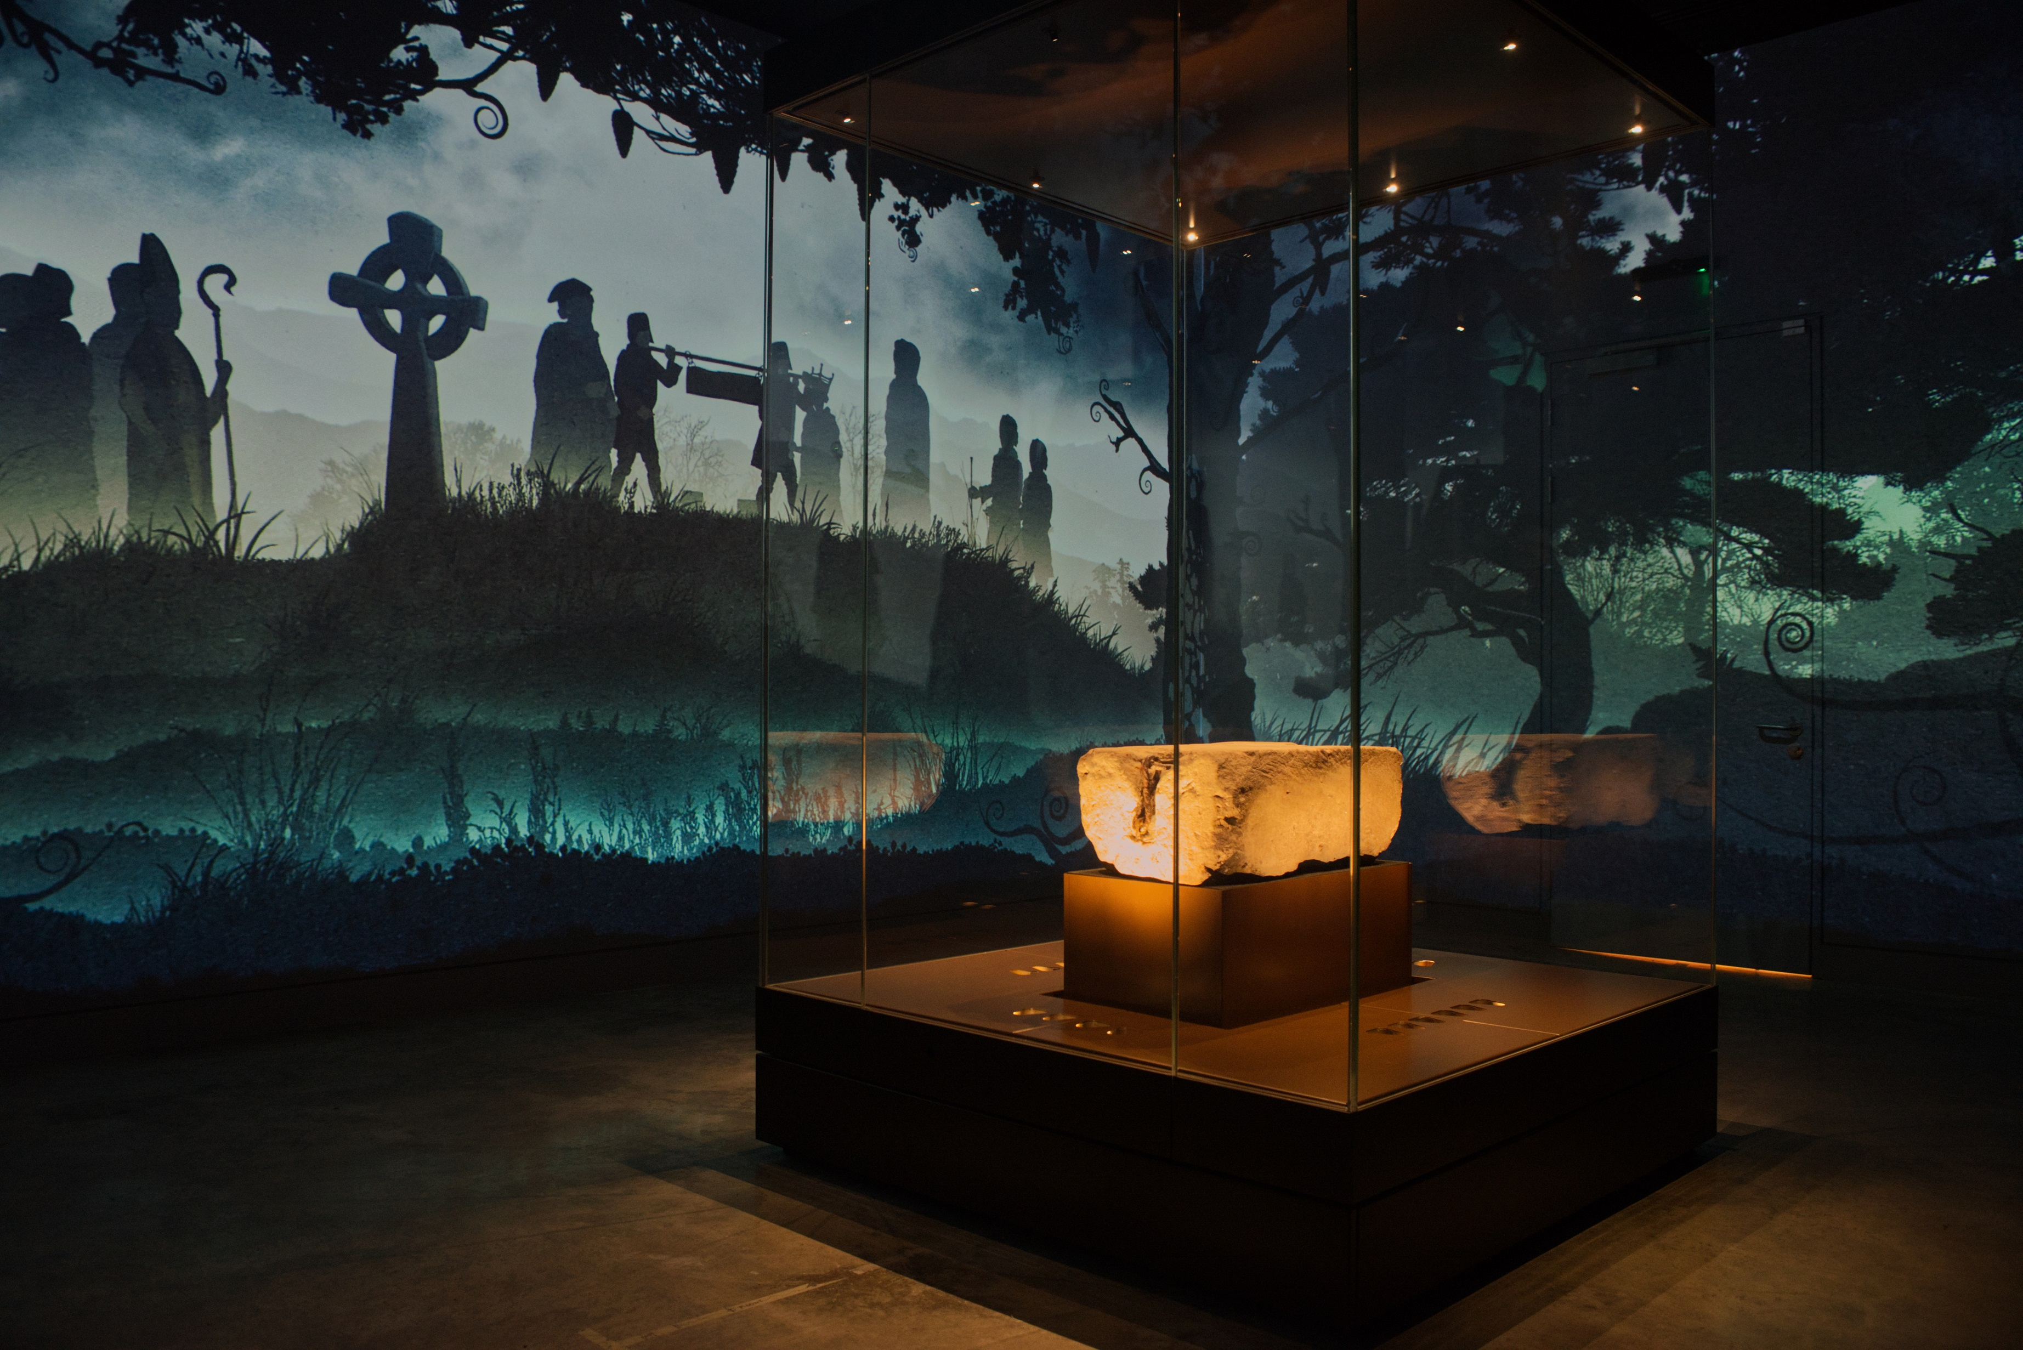
Annual Performance Report Highlights
The headlines of the Annual Performance Report this year are:
Tay Cities Region Deal marks half-way point as it entered Year 6 and has drawn down over half of the £300m funding allocated. To date, £156.892m of Government investment has been released.
£258m leverage has been secured by Projects within the Deal. This equates to 65% of the overall leverage commitment of the Deal.
5,307 jobs realised by Projects since Deal signing, split into new jobs, construction jobs and protected jobs:
2,312 new jobs
1,322 construction jobs, and
1,672 protected jobs
© Rob McDougal

Slide 3
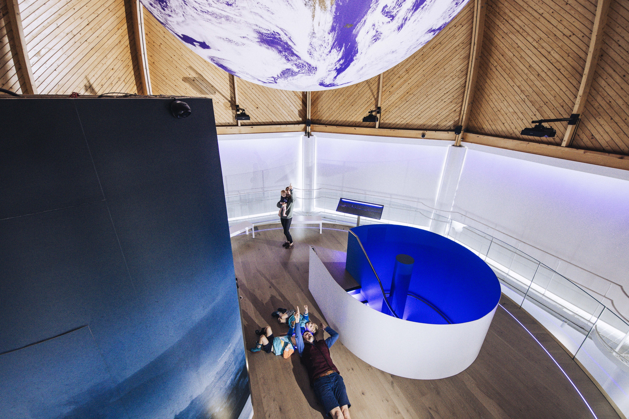
Annual Performance Report Highlights
Achievements within the Annual Performance Report include:
Perth Museum was one of the five finalists for Art Fund Museum of the Year 2025, the world's largest museum prize.
Growing the Tay Cities Biomedical Cluster Project is now complete.
The James Hutton Institute had First Minister John Swinney and Secretary of State Ian Murray officially opened the Advanced Plant Growth Centre.

Slide 4
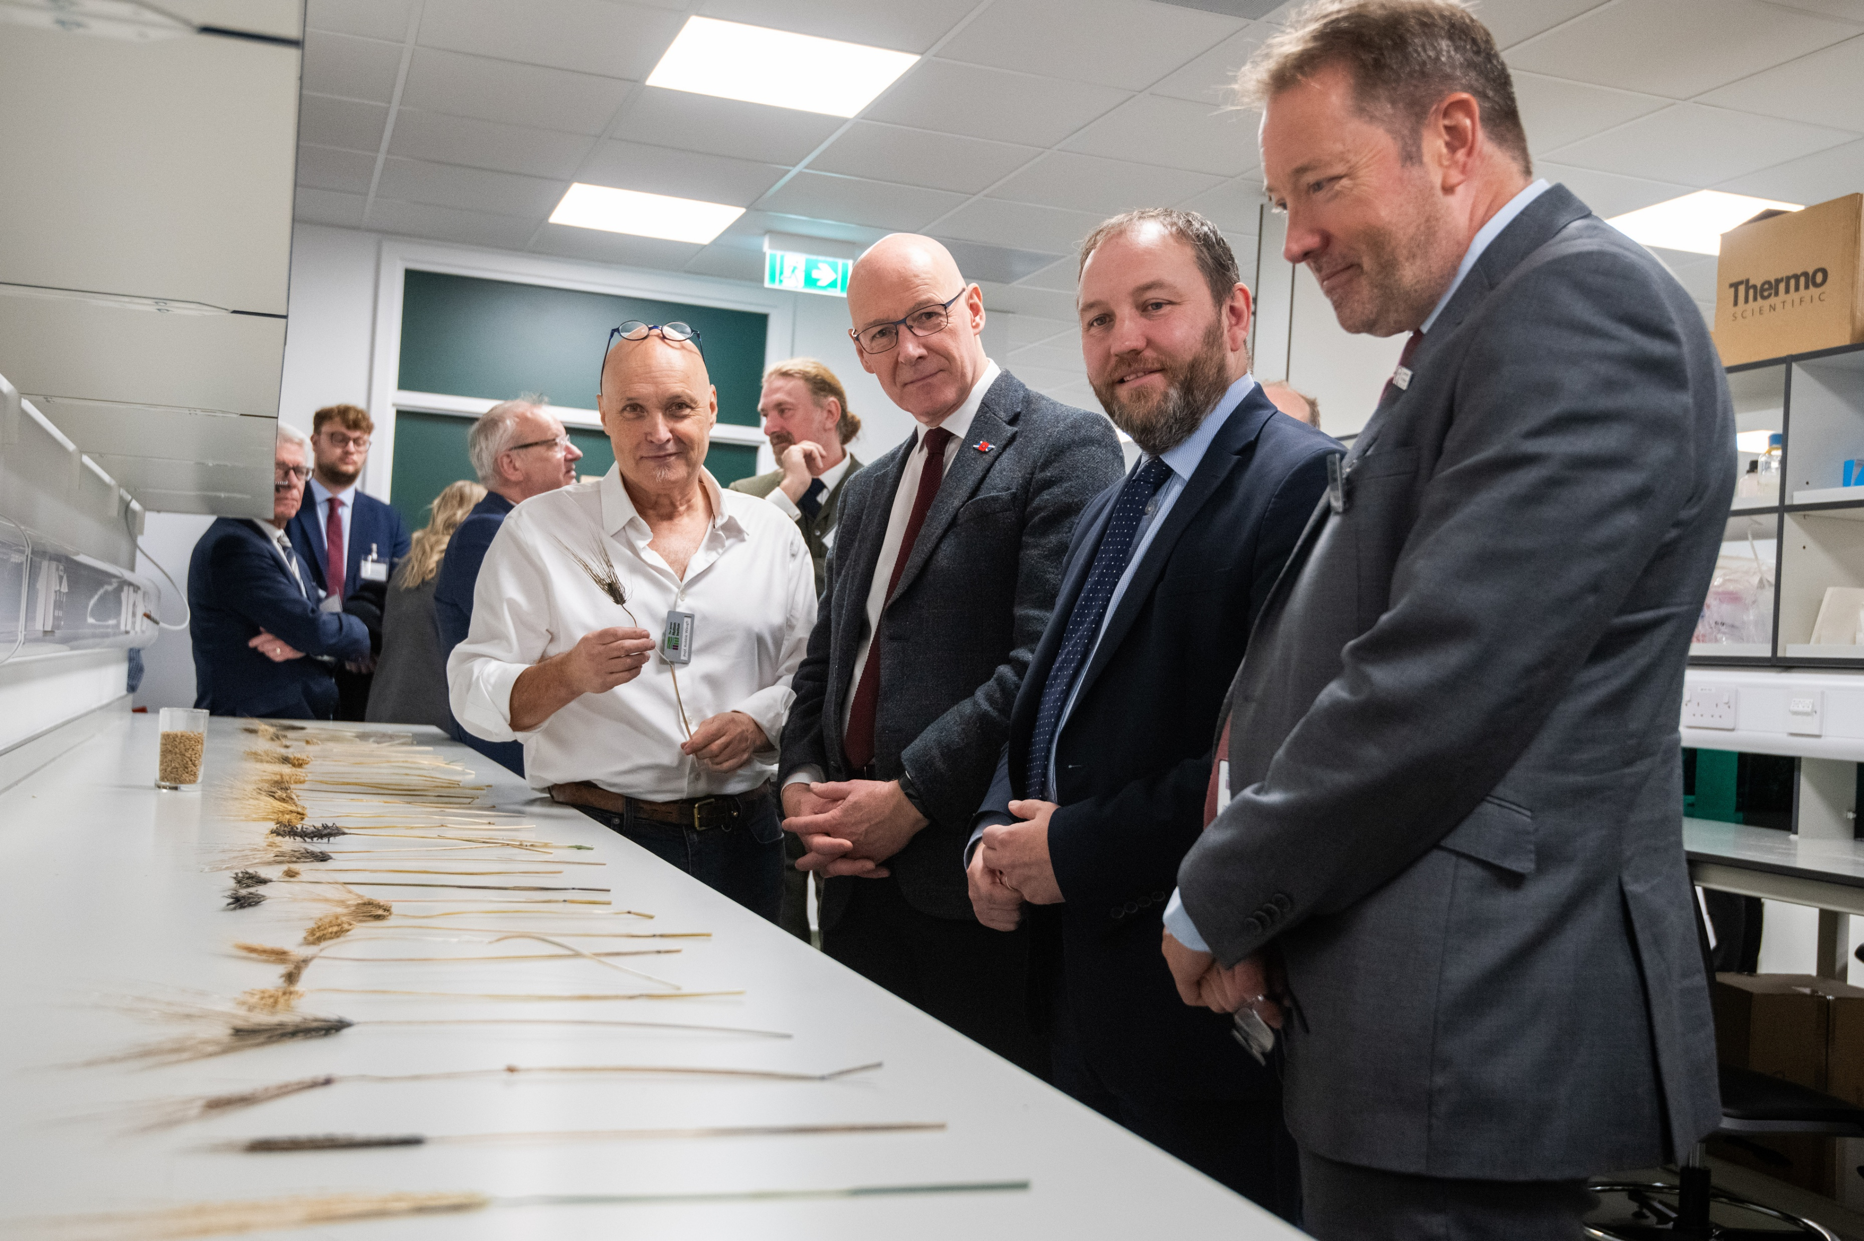
Benefits Realisation Plan Highlights
Grant Offer Letter commitment for a Benefits Realisation Plan
This is the Partnership’s fifth Benefits Realisation Plan – the Partnership’s approach to monitoring & evaluation
TCRD PMO continues to actively engage with PMO National Benefits Realisation sub-group to streamline and improve reporting
Projects are asked to report benefits annually in Q2 to align with the Annual Performance Report

